Slide 1
Form, Value Scale, still life
Value Scale and Form

Slide 2
Shape review
Shapes are anything that is enclosed and is 2d meaning flat.
Why is shape so important in art?
What is the difference between 2d and 3d? Or shape and form?

Slide 3
Form
Form is 3d and may be seen from multiple sides or looks like it is seen from multiple sides.
In art, drawn 3d objects have values.

Slide 4
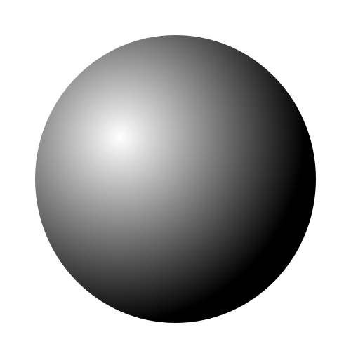
Shape vs. Form
What is the difference between these two shapes?

Slide 5
Shape vs. Form
This shape is 2d and is flat. It has no values and is not a form.

Slide 6
Shape vs. Form
This form has values and looks like a sphere not just a flat circle.

Slide 7
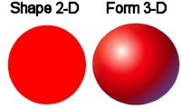
Why Values and form
Why do we have to have values in our drawings?

Slide 8
Value Scale
What is the value scale?
Why is the value scale important in art?
How is the value scale created?

Slide 9
Value scale
How are these elements used in creating the value scale in an art piece?
Form
Light source
Tint
Shade
Cast shadow

Slide 10
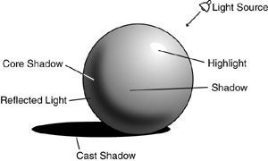
Describe the values
Describe how this form has been created using the value scale.

Slide 11
Lets create
Using the worksheet given lets label one shape together with out areas of shadow and light source.
Next finish the last 2 shapes with a labeled light source and visual shadows.

Slide 12
Creating a guide
Using the given grid create a value scale in graphite and then create a second value scale in 1 color.
Refer back to your grid often when using values in artwork.

Slide 14
Still Life Art
Still life art is a very old art form.
When artists didn’t have models to paint they made their own still life arrangement.
Still life paintings went through different phases of popularity.
What kinds of still life paintings have you seen. Example floral arrangements.?

Slide 15
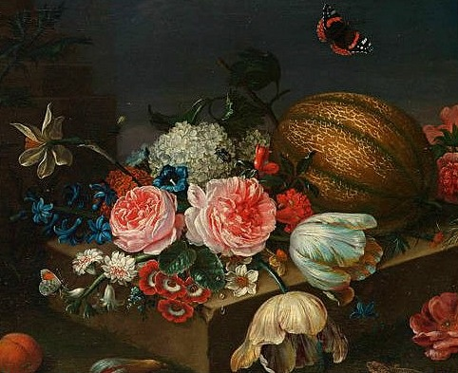
Painting examples

Slide 16
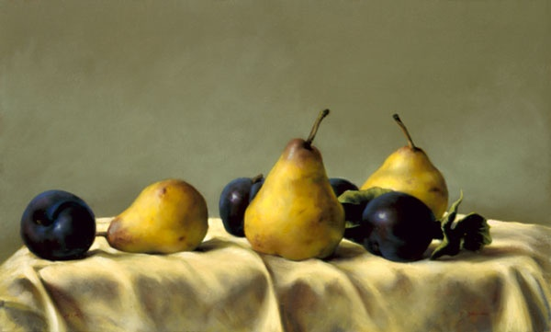
Painting examples

Slide 17
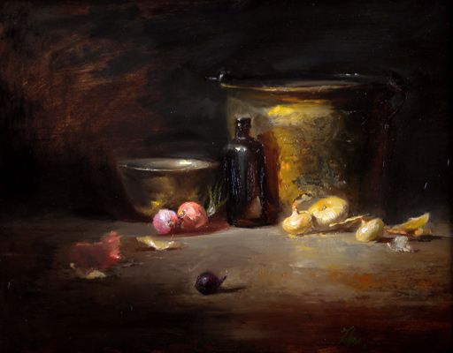
Painting examples

Slide 18
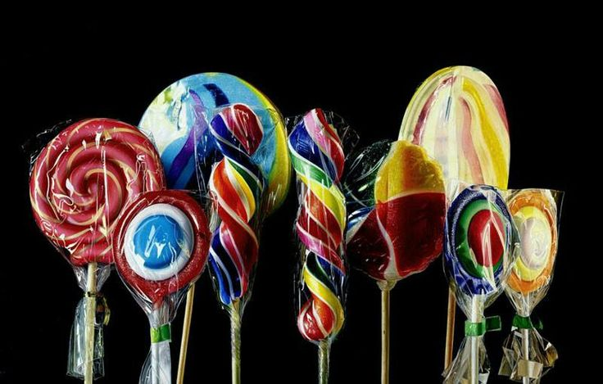
Painting examples

Slide 19
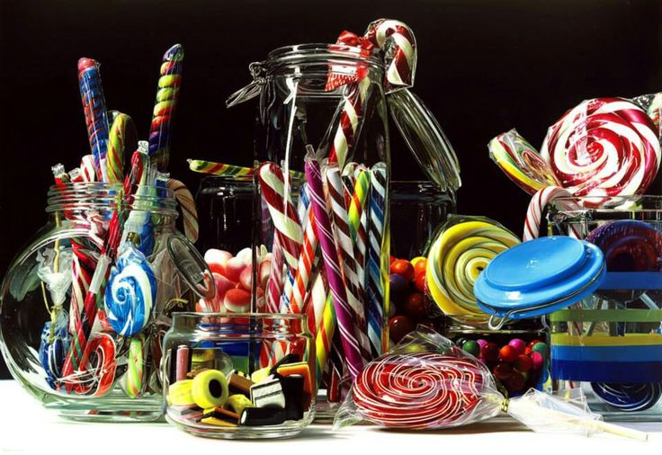
Painting examples

Slide 20
Exploring Form and Values- line to shape to form
Create a contour line shoe- what is contour line?
When your proportions look correct begin to add values.
What happens to the contour line when you begin to add values?
When you have 5 or more values decide if you are done.

Slide 21
Your Artist
Vincent Van Gogh
You may know him for the Starry Night painter.
OR…
The guy who cut off his ear……

Slide 22
Your Artist
Before we get to the ear….
Van Gogh was a dutch painter who lived until the age of 37.
His most famous painting is the Starry Night.
Before the Starry Night he was well known for his sunflower still lives.

Slide 23
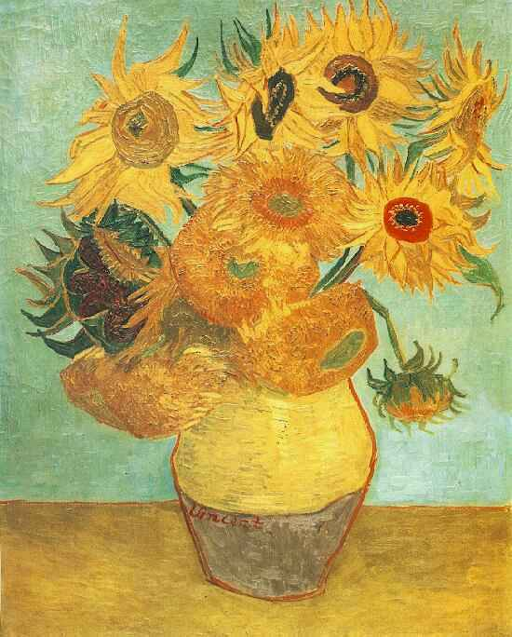
Van Gogh Still life

Slide 24
Van Gogh

Slide 25
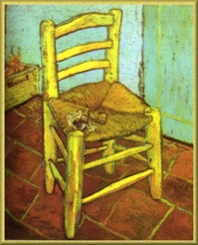
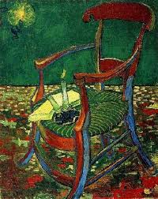
Van Gogh and the ear

Slide 26
Still life art and Values
You can’t have a finished still life without values.
Values make everything look real.
The point of still life art is to capture what you are drawing as real as possible.
It should look like you are drawing a photograph.

Slide 27
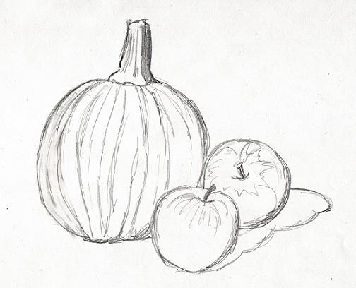
Still life with and with out values

Slide 28
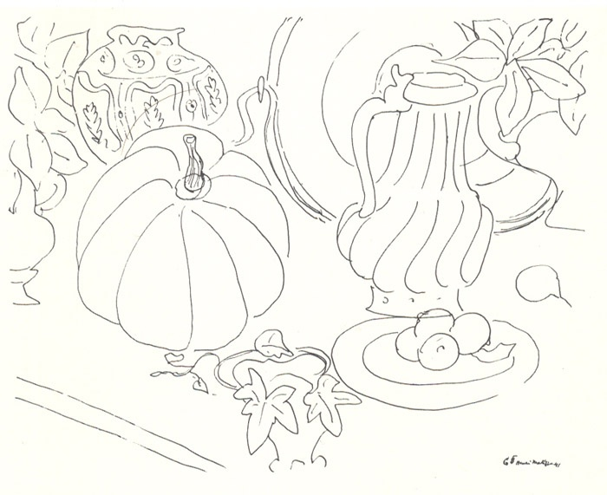
Still life with and with out values

Slide 29
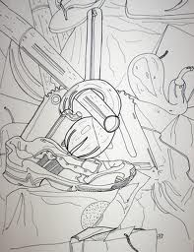
Still life with and with out values

Slide 30
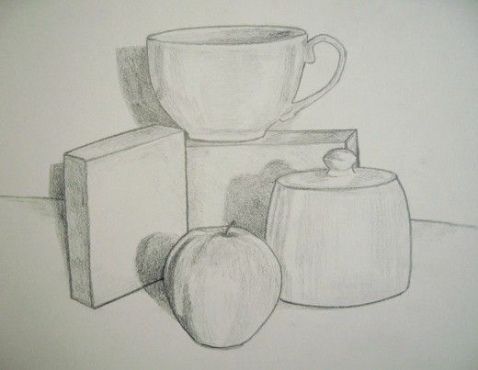
Still life with and with out values

Slide 31
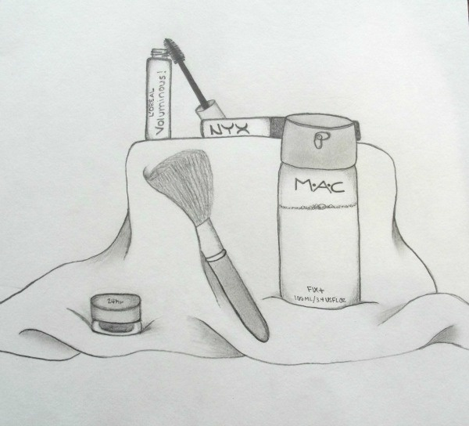
Still life with and with out values

Slide 32
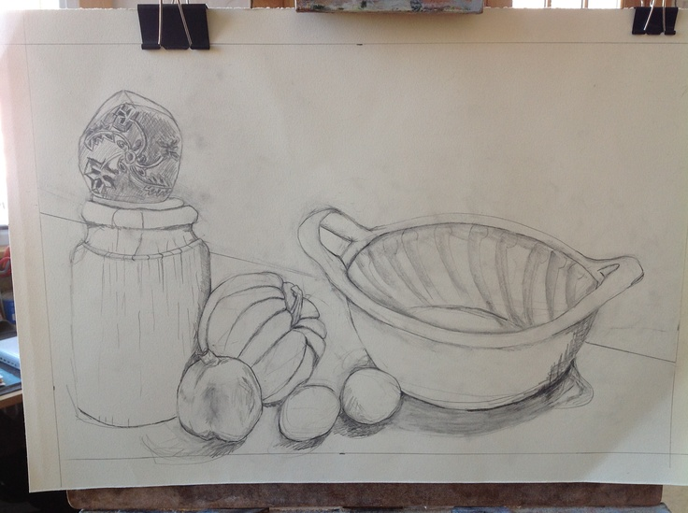
Still life with and with out values

Slide 33
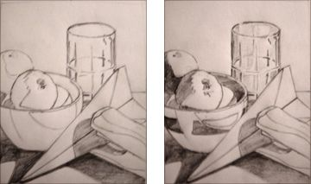
Still life with and with out values

Slide 34
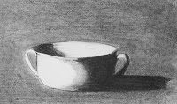
Still life with and with out values

Slide 35
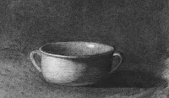
Still life with and with out values

Slide 36
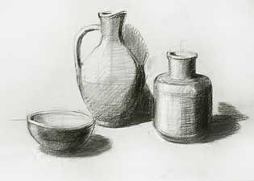
Still life with and with out values

Slide 37
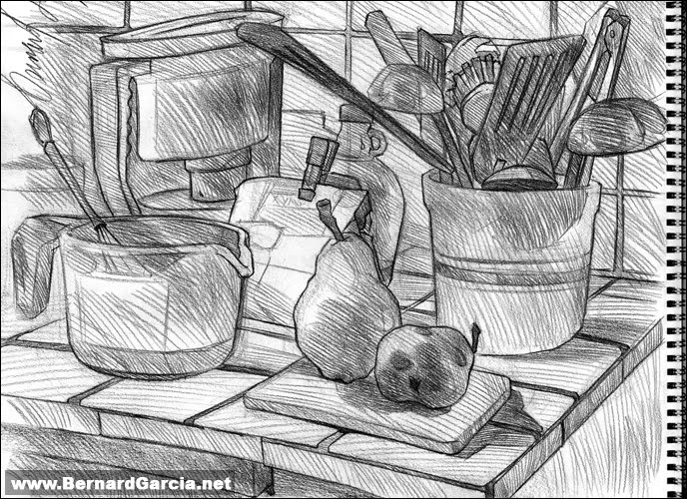
Still life with and with out values

Slide 38
composition
What is composition?
How can you create composition with your shoe project?
How does composition change your project?

Slide 39
Project steps
Bring in your shoe to class; you may not use a photograph, cell phone or computer
Create contour line of your shoe
Analyze the proportions of your shoe for correctness
Draw a square around 1 section of your show. The inside of this square will be done in markers with no values in order to compare 2d shapes and 3d forms.
Begin to add values to shoe
Compare your grid to your project to make sure you have all your values
Turn in and critique

Slide 40
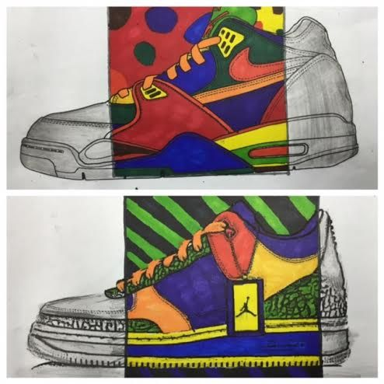
Examples

Slide 41
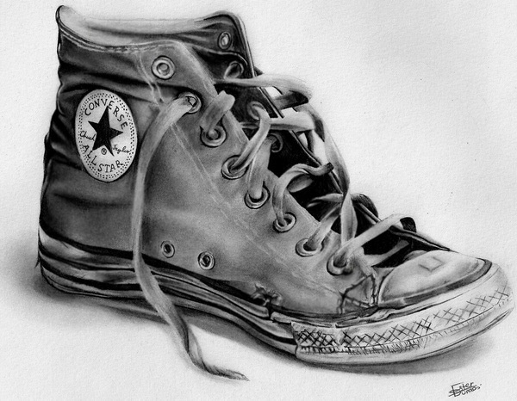
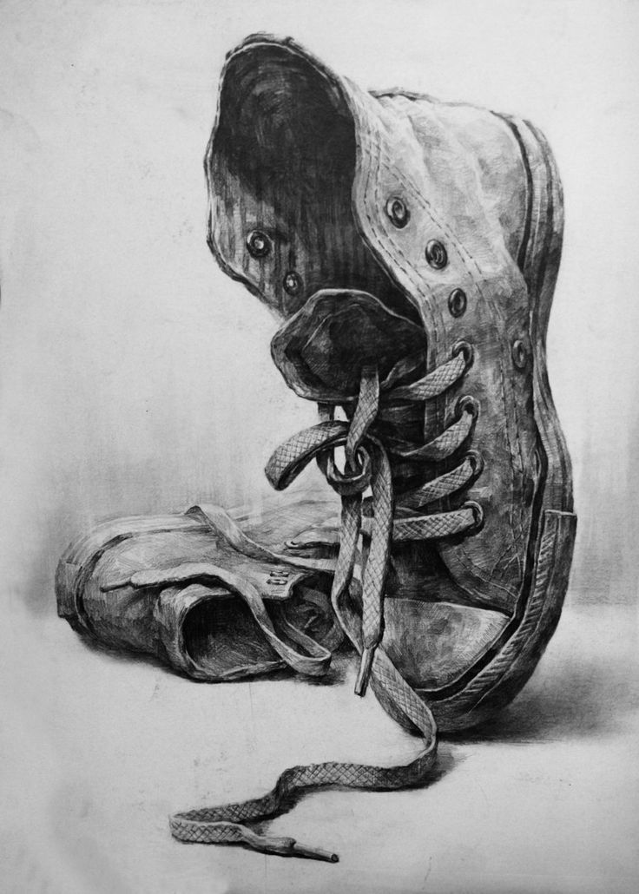
Examples

