Slide 1
Social Issues
Collage, social issues w/ research, street art/ graffiti, symbolism, sending a message through art

Slide 2
What is street art/ graffiti
what is street art?
What is graffiti?
Is there a difference between the 2?
Are they both considered art, why or why not?

Slide 3
Artist Bio
Read the artist bio and prepare to discuss

Slide 4
Message in art
How can art deliver a specific message?
How does street art deliver a message or does it?
Is street art and sending a message through art still valuable in todays society and why or why not?

Slide 5
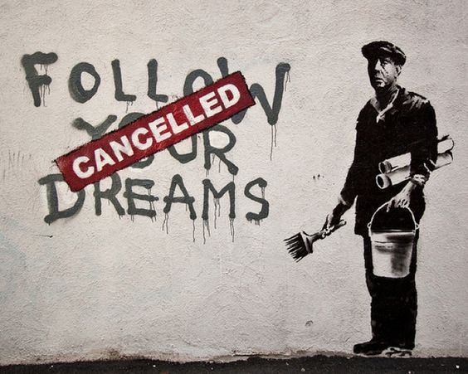
Street art and deciphering the message
What is the message and is it relevant in today’s society and current issues?

Slide 6
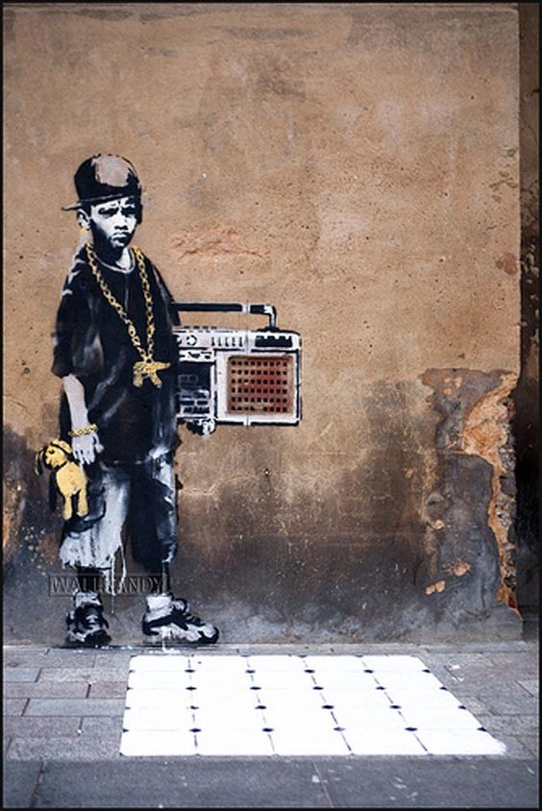
Street art and deciphering the message
What is the message and is it relevant in today’s society and current issues?

Slide 7
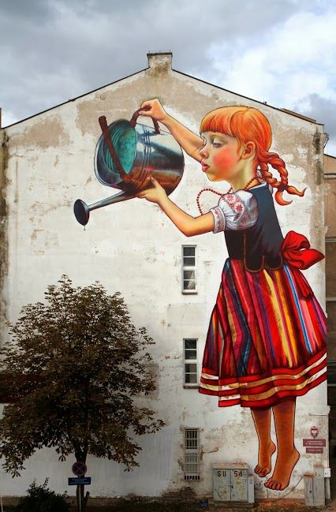
Street art and deciphering the message
What is the message and is it relevant in today’s society and current issues?

Slide 8
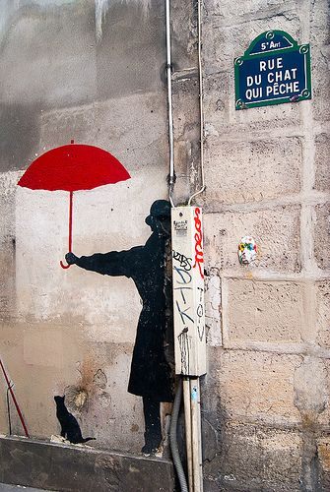
Street art and deciphering the message
What is the message and is it relevant in today’s society and current issues?

Slide 9
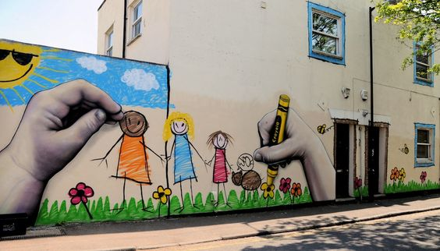
Street art and deciphering the message
What is the message and is it relevant in today’s society and current issues?

Slide 10
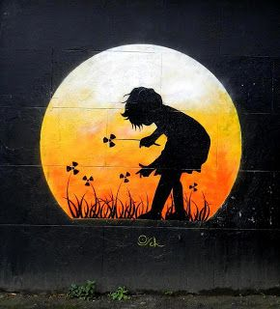
Street art and deciphering the message
What is the message and is it relevant in today’s society and current issues?

Slide 11
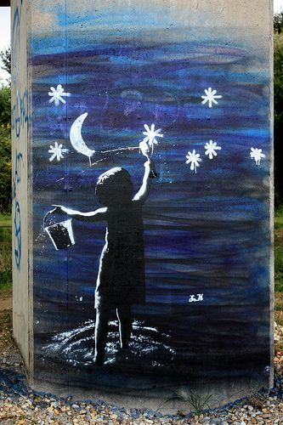
Street art and deciphering the message
What is the message and is it relevant in today’s society and current issues?

Slide 12
Symbolism
How does street art use symbolism and metaphor to deliver a message?

Slide 13
project
research a specific social topic current and relevant to today’s culture and society.
Research topic using databases instructed by Mrs. M
Find an article supporting your topic to be printed and displayed with your project
Create a graffiti style title to be printed
After researching apply your new knowledge to creating a collage of symbols and metaphors that deliver a specific message about your topic similar to the street art we studied.
Use drawings, words, magazine images/ words and even copies of your research to create your collage.
Create a background for your graffiti title
Present your collage and research

Slide 14
Project examples

Slide 15
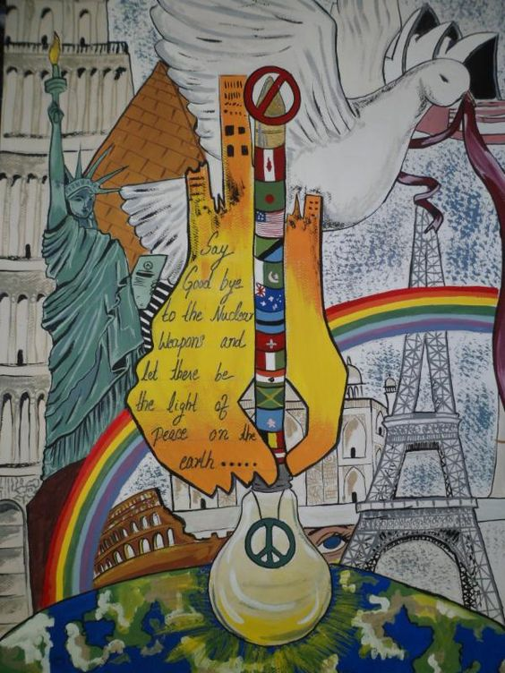
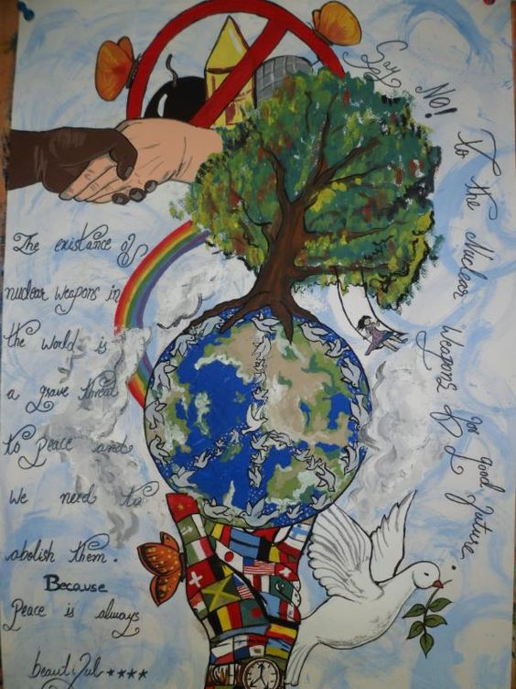
Project examples

Slide 16
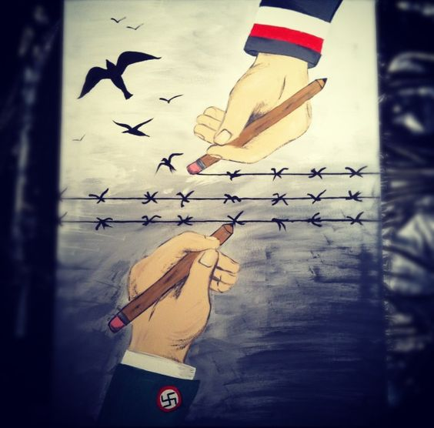
Project examples

Slide 17
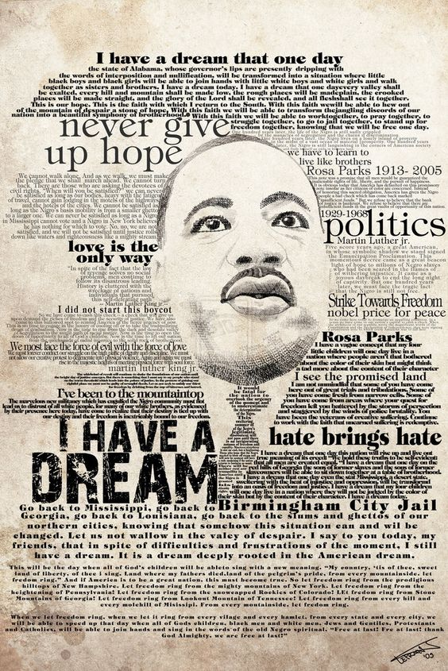
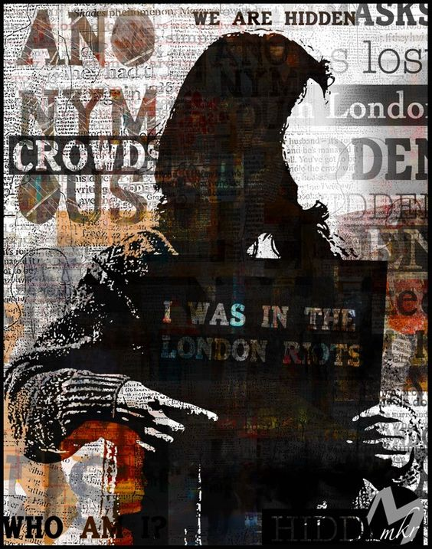
Project examples

Slide 18
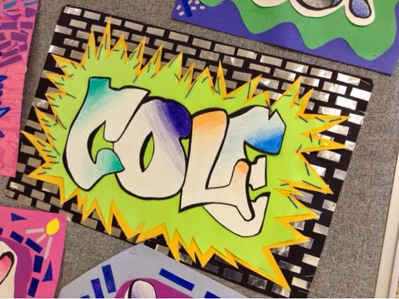
Bell Ringer
Begin to work on a background for your graffiti title.
Consider a brick wall, subway wall or a graffiti splatter wall

