Slide 1
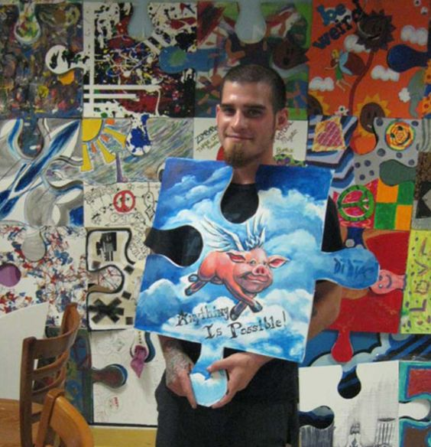
Mini Project/ Bell Ringer
Puzzle tile
2 weeks

Slide 2
Begin
This project was started by a professional artist to showcase individuals and what they believe is most important to them and to life. The show now contains hundreds of traveling puzzle pieces showcasing individual artists and common people.
Begin by tracing the stencil on your given project paper/ board
Cut out your puzzle piece and set aside *MAKE SURE YOUR NAME IS ON IT!
Begin to sketch ideas for what you believe is most important. This can be personal to you or broader and pertain to life in general. Think about current issues in the world and the world you wish to live in as an adult.

Slide 3
Bell Ringer
Work on your puzzle piece for 10-15 minutes each class (at the beginning of class or in free time).
You will have almost 2 weeks to complete your puzzle piece and it will be graded as a project grade.
Material choices are laid out for your choice, choose appropriately and wisely for your ideas.
*you should not work on puzzle pieces during regular project time.

Slide 4
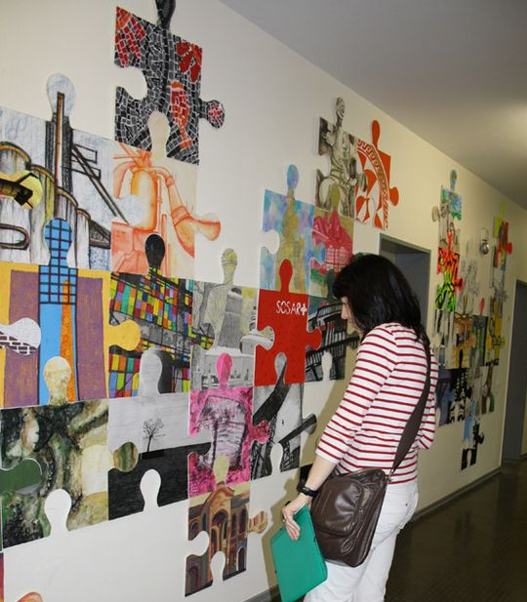
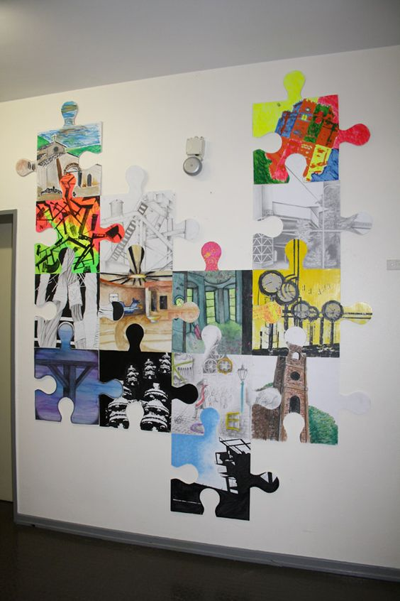
Examples

Slide 5
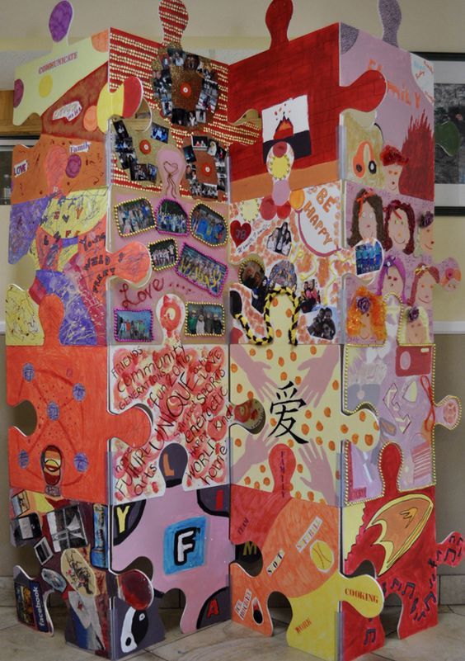
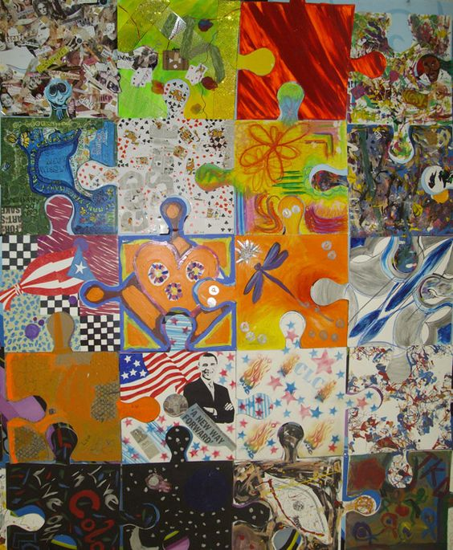
Examples

