Slide 1
Pandora’s Box
Clay, mixed media, Pandora’s box, 3d art

Slide 2
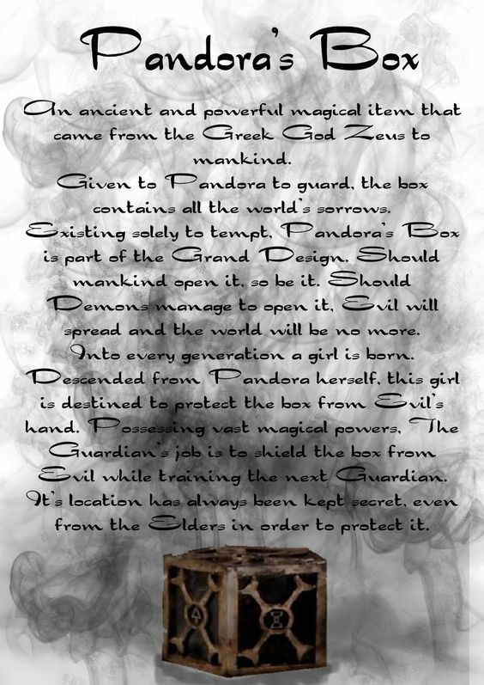

Slide 3
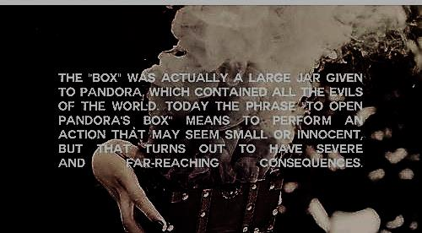

Slide 4
Read and explore
Read the given handout and use technology in groups to explore and find the legend of Pandora's box. Each group should be prepared to share what they have found and notes they have written 10-15 mins

Slide 5
Your idea/ box
On the prepared worksheet describe your own personal pandora’s box. What does it look like, what does it contain, what will happen if opened. You may write this in a story format and it should be minimum 15 sentences. Due end of class tomorrow. 10 mins.

Slide 6
Clay terms
On the given study guide take notes for the test.
Clay- Clay is a special kind of earth which is made by the decomposition of rocks through the action of weathering.
SLAB - Roll the clay into flat sheets (like a pie crust) to cut apart and assemble.
COIL - Roll out long snakes of clay and twist them into coils and shapes.
Slip: This is liquid clay ... clay with a lot of water added to it. It is used in ceramics (poured into molds). It is also sometimes used as a sort of glue to hold clay pieces together. You need to use slip to "fasten" pieces of clay together so that they don't fall apart in the kiln

Slide 7
Clay terms
Slab Roller- tools used to flatten and roll out thin sheets of clay for building.
Score and slip- in order for slip (clay glue) to work, the clay must first be scored or scratched into on both pieces of clay that are to be attached. Score both pieces of clay with a clay tool, add slip to both pieces and softly press and wiggle together.
Functional- before clay artwork was created for decorations it was functional. Functional clay was clay used in daily life for survival and everyday purposes. Dinnerware, storage, water gathering
Form- 3d structure can be seen from multiple sides. Sculpture

Slide 8
Additional terms
Mixed media- artwork that uses multiple mediums (tools and materials) . Collaged materials, drawing, painting, text, sculpture, photographs.
Surface treatment- how the surface of a sculpture looks and is created. This can be through glaze, paint, texture, mixed media, collage, oil pastel, etc.

Slide 9
Demo
Watch the demonstration for building your clay box.
Slab-
Stencil and cutting walls-
Attaching walls w/ coils
Score and slip
Adding texture
Storing

Slide 10
Groups
½ class clay building at a time w/ teacher
½ class creating mixed media materials for box

Slide 11
Mixed media
Magazines
Hand drawn images
Printed images (small and very few)
Small sculptures
Stamps
Found materials
Bought materials
paint (dry)
Oil pastels (dry)

Slide 12
Project
Explore Pandora’s Box
Create a 3d clay box that explores your own ideas of Pandora’s Box
Create a written description or story of your Pandora’s Box
Explore mixed media through chosen and appropriate materials
Explore the connection of mythology, literacy and art

Slide 13
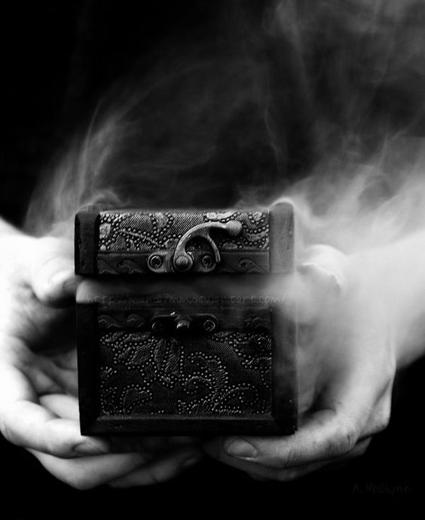
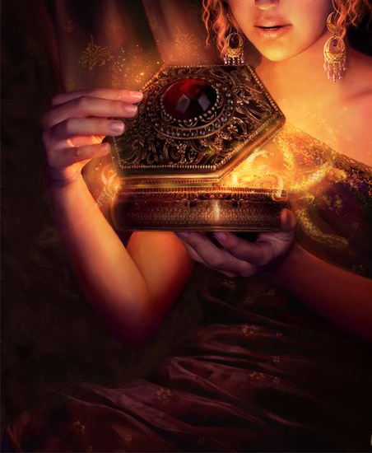

Slide 14
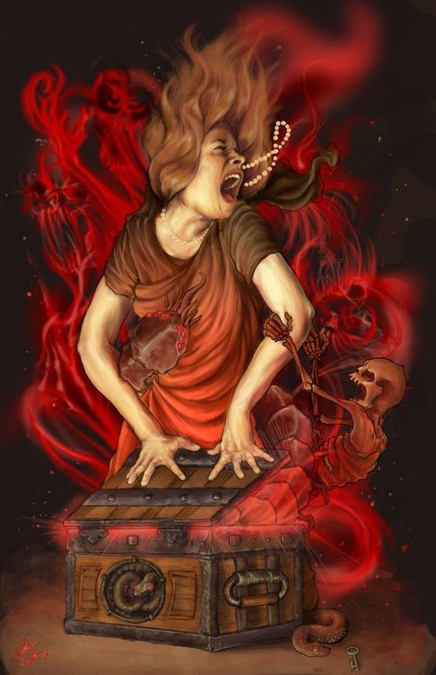

Slide 15
