Slide 1
Memory Portraits
Memory, portraits and selfies, grid portraits, chuck close, value scale

Slide 2
Self Portrait and Selfie
How has the self portrait evolved over time?
Why were self portraits so important?
Do we still value the self portrait as much as we did during traditional art times?
What is a selfie?
Group questions- work as a group to discuss the questions as they pertain to a selfie and a self portrait. 10 mins before class discussion
Take a selfie to be printed on my phone and hung next to your self portrait for comparison.

Slide 3
Chuck Close
Read the brief biography about Chuck Close
Class discussion and share out.
observe the painting created by chuck close on the next slide, what do you see and what do you notice?

Slide 4
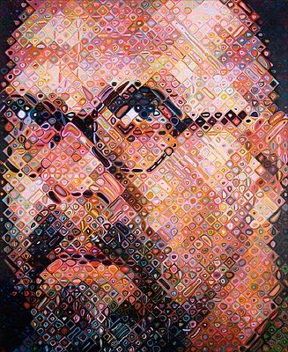

Slide 5
Chuck Close and the grid
Group Share outs…..
Spinal injury and Face Blindness
Why would someone use a grid in art?
Proportions in art and math….

Slide 6
Chuck Close and the grid
Group Share outs…..
Spinal injury and Face Blindness
Why would someone use a grid in art?
Proportions in art and math….

Slide 7
Line
How can line be used in creating a grid?
How can line be used differently when drawing on top of a grid…..
Think and discuss in you groups.
Share out.

Slide 8
Using a grid
When using a grid we are making sure out artwork is what….?
How many grids do we technically have to use when using this technique?
What are the benefits of using a grid?

Slide 9
Benefits of a grid
Creates proportional art work
Helps our art look more realistic
Breaks down hard to draw artwork into sections
Creates a guide for our eyes to follow
Helps us check our artwork.

Slide 10
Grid vs. Freehand
What are the differences between grid drawing and freehand drawing?
What are the benefits of both?

Slide 11
Shape review
Shapes are anything that is enclosed and is 2d meaning flat.
Why is shape so important in art?
What is the difference between 2d and 3d? Or shape and form?

Slide 12
Form
Form is 3d and may be seen from multiple sides or looks like it is seen from multiple sides.
In art, drawn 3d objects have values.

Slide 13
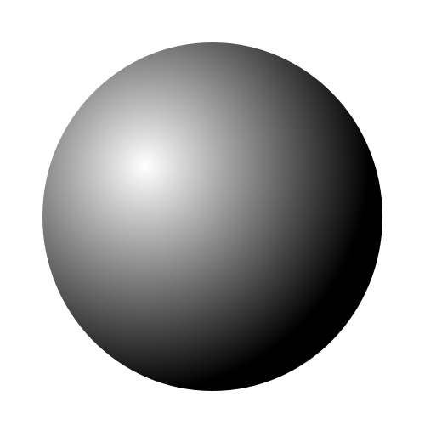
Shape vs. Form
What is the difference between these two shapes?

Slide 14
Shape vs. Form
This shape is 2d and is flat. It has no values and is not a form.

Slide 15
Shape vs. Form
This form has values and looks like a sphere not just a flat circle.

Slide 16
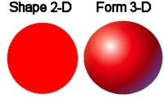
Why Values and form
Why do we have to have values in our drawings?

Slide 17
Value Scale
What is the value scale?
Why is the value scale important in art?
How is the value scale created?

Slide 18
Value scale
How are these elements used in creating the value scale in an art piece?
Form
Light source
Tint
Shade
Cast shadow

Slide 19
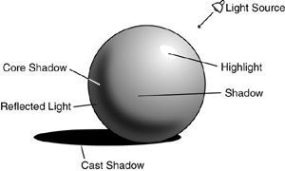
Describe the values
Describe how this form has been created using the value scale.

Slide 20
Creating a guide
Using the given grid create a value scale in graphite and if time allows create a second value scale in 1 color.
Refer back to your grid often when using values in artwork.

Slide 22
Value scale and portraits
Why is the value scale going to be so detrimental in creating your self portrait?

Slide 23
Memory as a theme
What is memory?
How can we all share the same memory but with differences?
How do we communicate memory?
Why are memories important to us as individuals?
Why are memories important to groups, cultures and societies?

Slide 24
Memory portraits
Look at the next portraits and make observations about how the art is made, what the memory is and how it is being communicated.

Slide 25
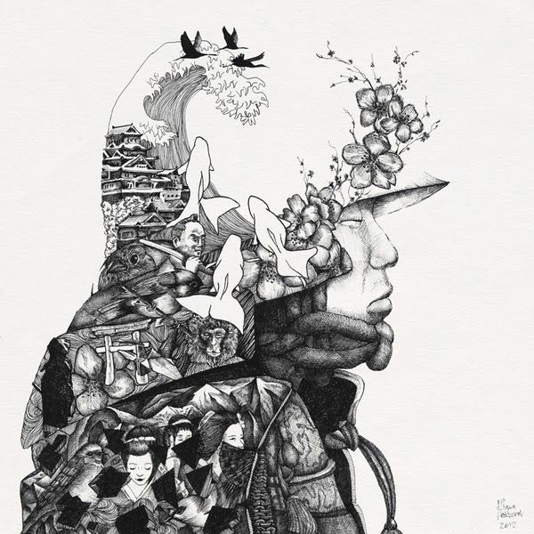

Slide 26
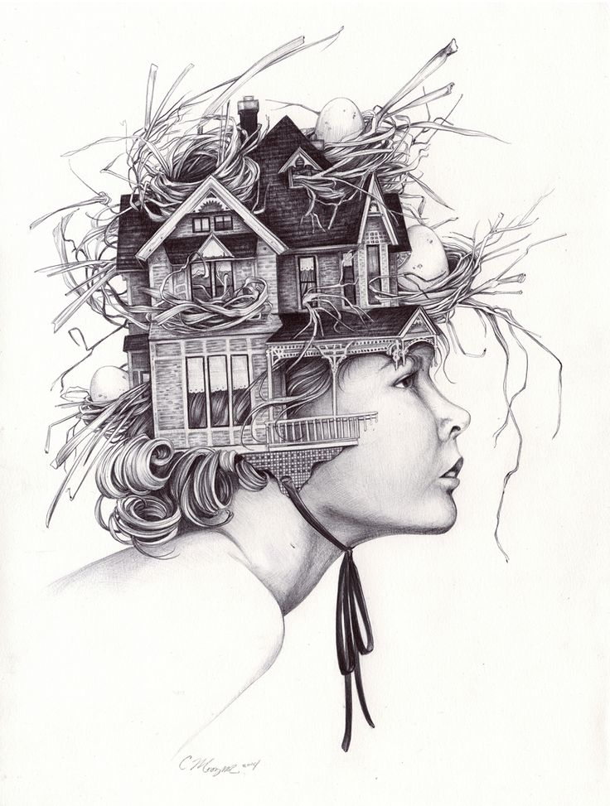

Slide 27
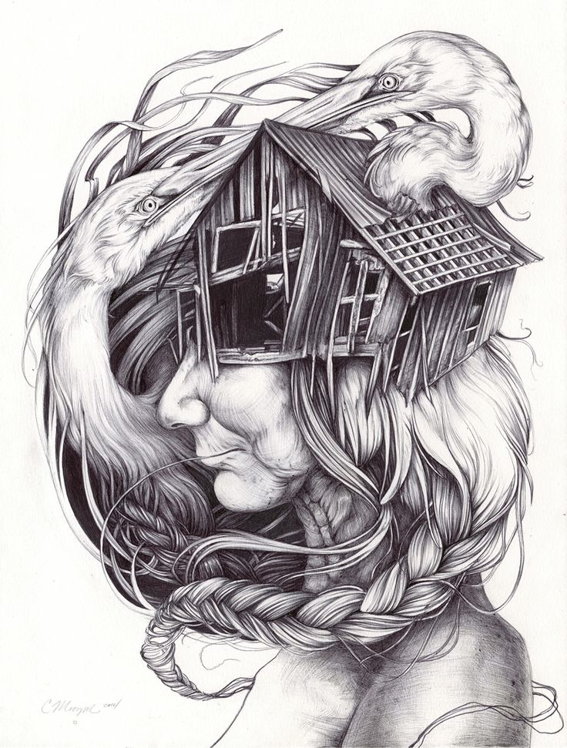

Slide 28
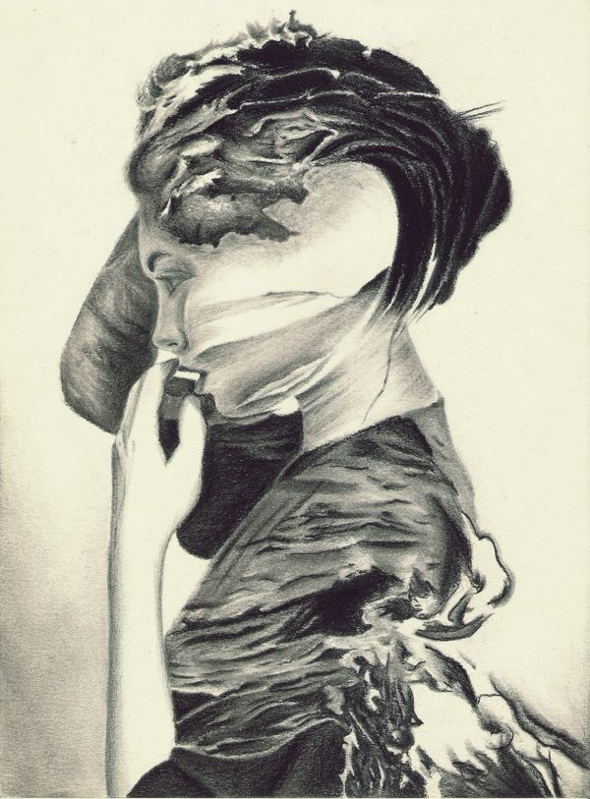

Slide 29
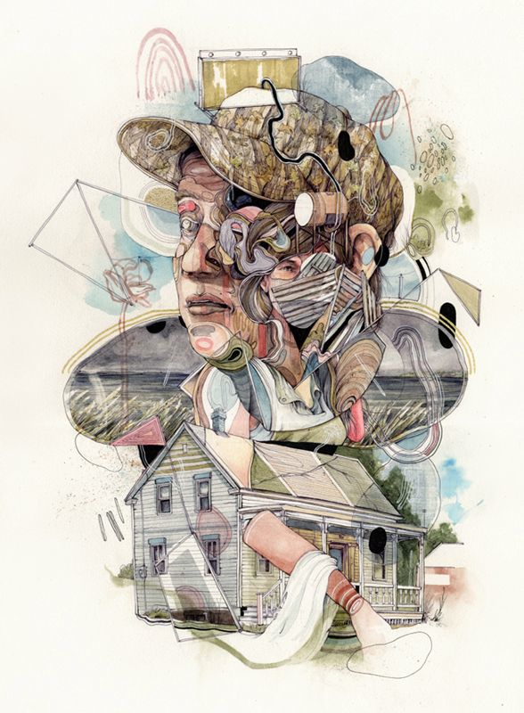

Slide 30
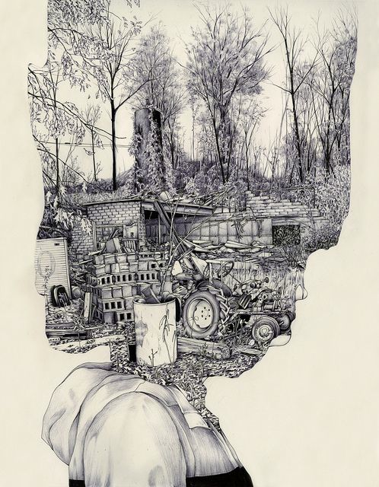

Slide 31
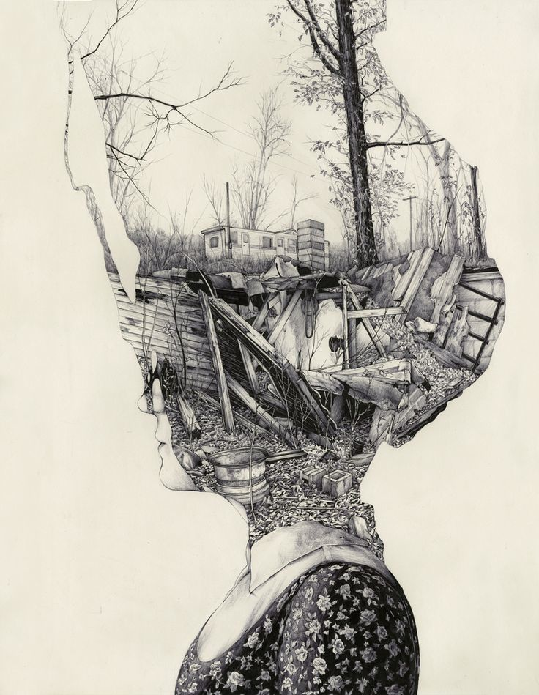

Slide 32
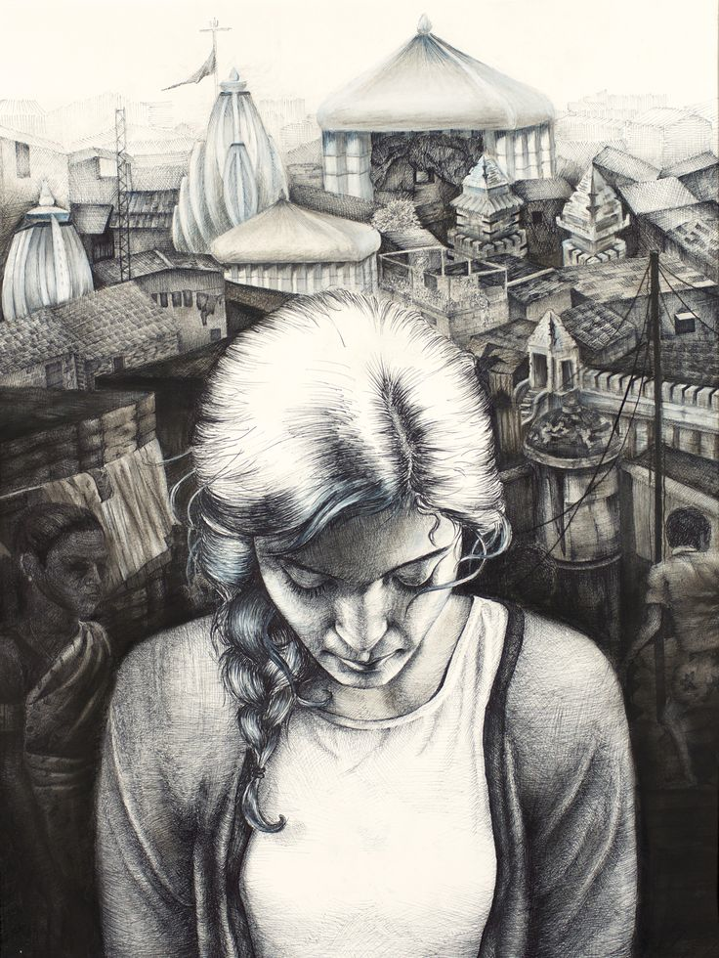

Slide 33
Project objectives
Explore portraiture and how the term has changed through history
Compare self portrait to a selfie and the meanings behind each
Explore artist chuck close and the use of a grid
Explore and use the value scale successfully to create your self portrait
Explore memory as a theme through a personal memory
Explore portraits through freehand drawing or grid drawing both from an image
Explore chosen media- pencil, charcoal, ink

Slide 34
Grades
Selfie activity w/ student selfie
Chuck close bio read and share
Value scale *turned in w/ portrait
Memory description *turned in w/ sketch
Memory portrait w/ grid
Overall project

