Slide 1
I am Collage
Personal Identity, collage

Slide 2
Personal identity
What is personal identity?
How can art display someone's identity?
Does the artist create a personal identity artwork to inform others of their personal identity or is it for themselves to explore who they are….or both and why?

Slide 3
Personal identity
What things do I need to know about myself and my identity in order to create a personal identity artwork?
Can my identity and the answers from the previous question change?

Slide 4
collage
What is a collage and what are the benefits of using a collage technique when creating artwork?
What materials can I use in a collage?

Slide 5
I am poem
An I am poem tell the reader in a narrative format qualities about you, therefor informing others about your personal identity.
The poem can still be written using symbolic language and metaphors making your personal identity remain somewhat mysterious.
Example
I hear….the clanging of swords, the cry of fallen heroes and the laughter of villains
This line tells readers from my I am poem that I like to read and that I am an observant and imaginative reader because of the details I included without stating in a very obvious manner ” I like to read.”

Slide 6
I am poem
Create your own I Am Poem once or twice before beginning your final project.
Experiment with different adjectives and metaphors in your poem
Have 2 or more classmates proofread your poem before beginning your collage.

Slide 7
Collage/ project
After finalizing your I Am Poem begin to create your collage from a mixture of materials
Your poem must be included somewhere on the collage
A minimum of 3 different materials must be used

Slide 8
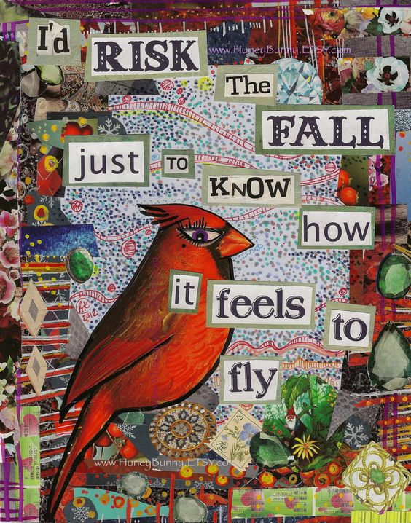
Examples

Slide 9
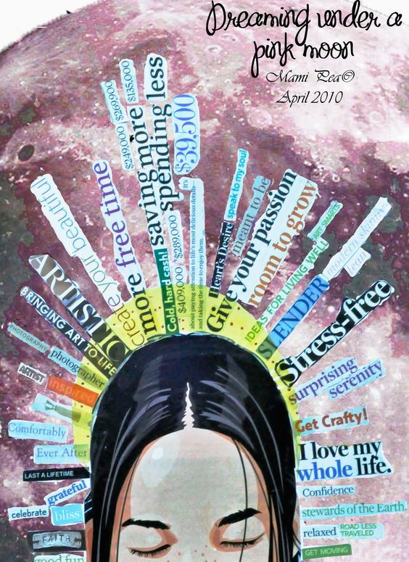
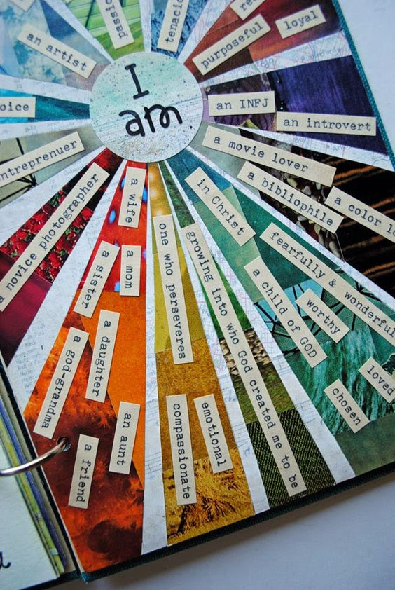
Examples

Slide 10
objectives
Explore personal identity as a theme in art
Explore poetry as a foundation for artmaking
Create an I am poem
Explore collage as a medium and technique in art
Create a collage that uses my I am poem

