Slide 1
Creating perspective
One point perspective, Hand-scapes, landscape bell ringer, surreal art, Dali

Slide 2
Perspective
What is perspective?
How something is seen or the point of view
How does perspective effect things around it….?
Creates depth making things seem bigger or smaller than they may actually be.

Slide 3
Atmospheric Perspective
is the effect you get when far away objects take on the colors of atmospheric haze.

Slide 4
Landscape
What are the 3 rules to creating a landscape that is correct?
How does a landscape incorporate similar rules to perspective?
Foreground
Middle ground
background
?

Slide 5
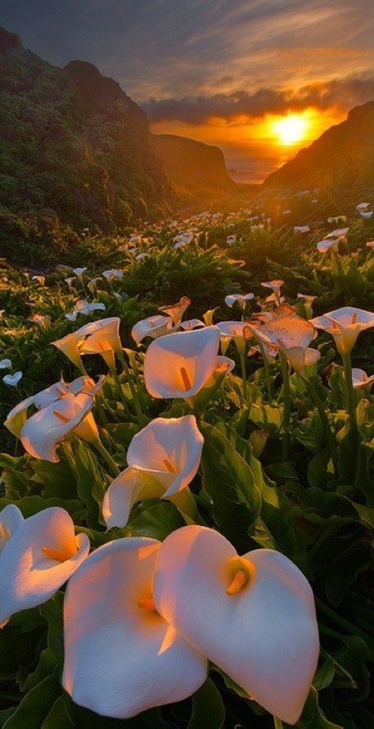
What is a foreground?

Slide 6
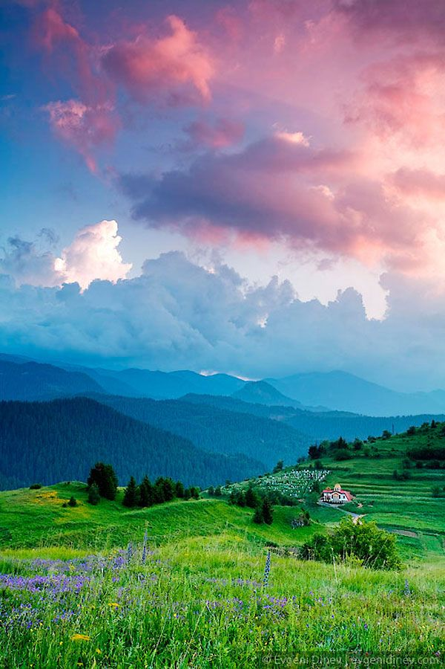
What is a Middle Ground?

Slide 7
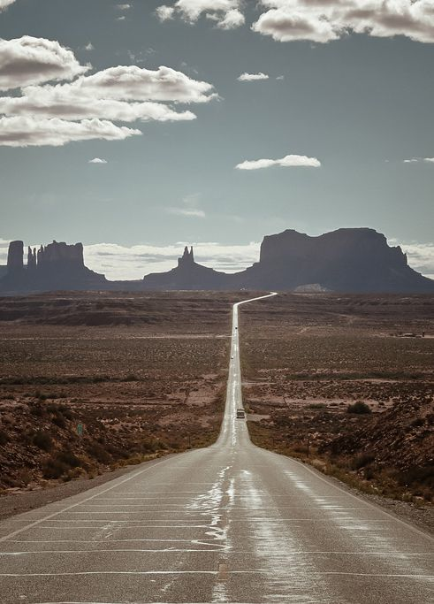
What is a Background?

Slide 8
Perspective activity
On sketch paper create a landscape with the theme of fall or Halloween that has a very obvious foreground, middle ground and background.
Turn in when complete
Must have full shading or full color

Slide 9
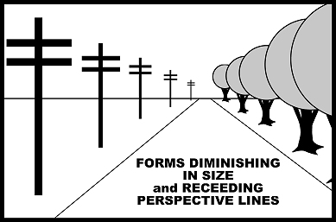
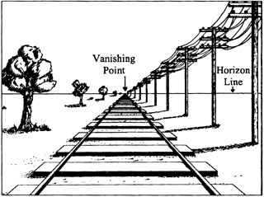

Slide 10
Surreal Art
A cultural movement that began in the 1920’s.
Artists aimed to break away from the rigid rules of the art world to create more dream like images.
Combined fantasy, imagination, dreams and realism to create an unsettling painting.
Usually had some sort of element of surprise or the unexpected.
Creatures from everyday objects

Slide 11
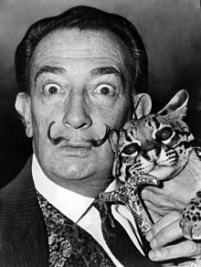
Salvador Dali- Bio Read
Read the biography and prepare to discuss
Dali was a prominent Spanish Surrealist artist.
He was known for creating bizarre images in his artworks
Had an extremely eccentric personality and imagination
Most famous painting is: the persistence of memory.

Slide 12
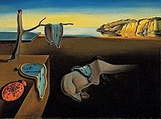
Dali

Slide 13
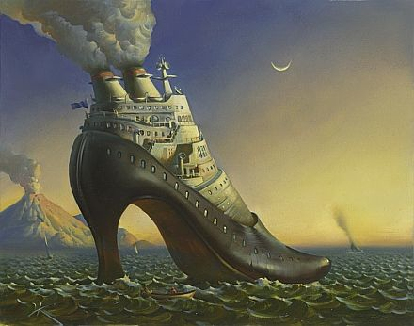
examples

Slide 14
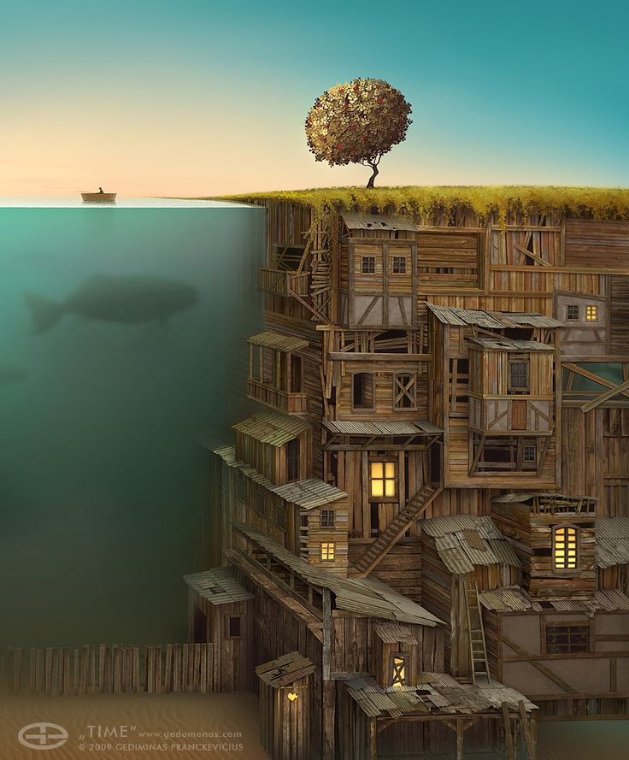
examples

Slide 15
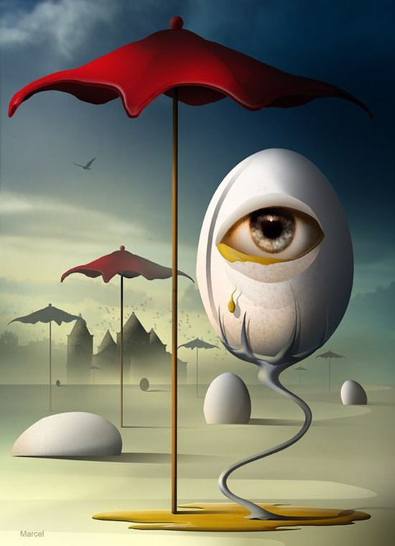
examples

Slide 16
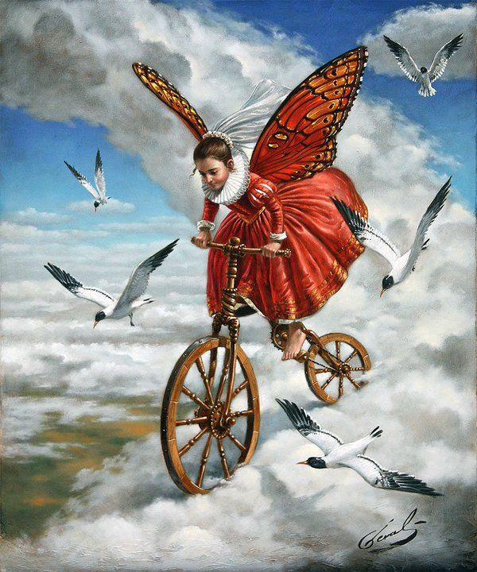
examples

Slide 17
Hand-scape Project
Create a surrealist inspired project by:
Using your theme
Creating a dream
Using the element of surprise as your contour hands

Slide 18
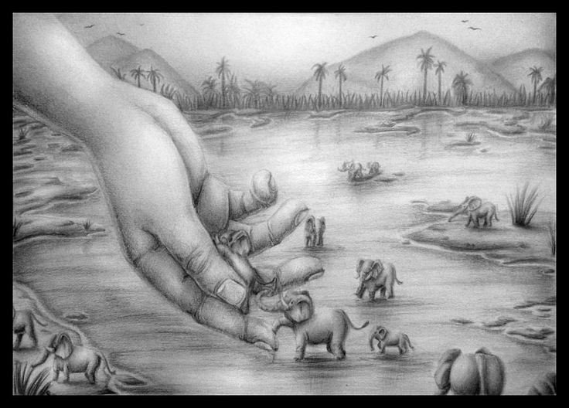
examples

Slide 19
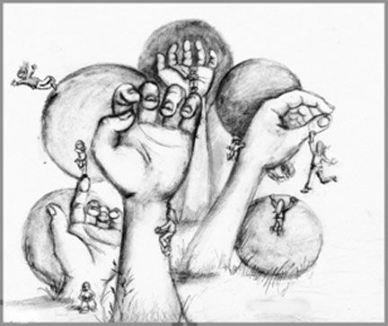
examples

Slide 20
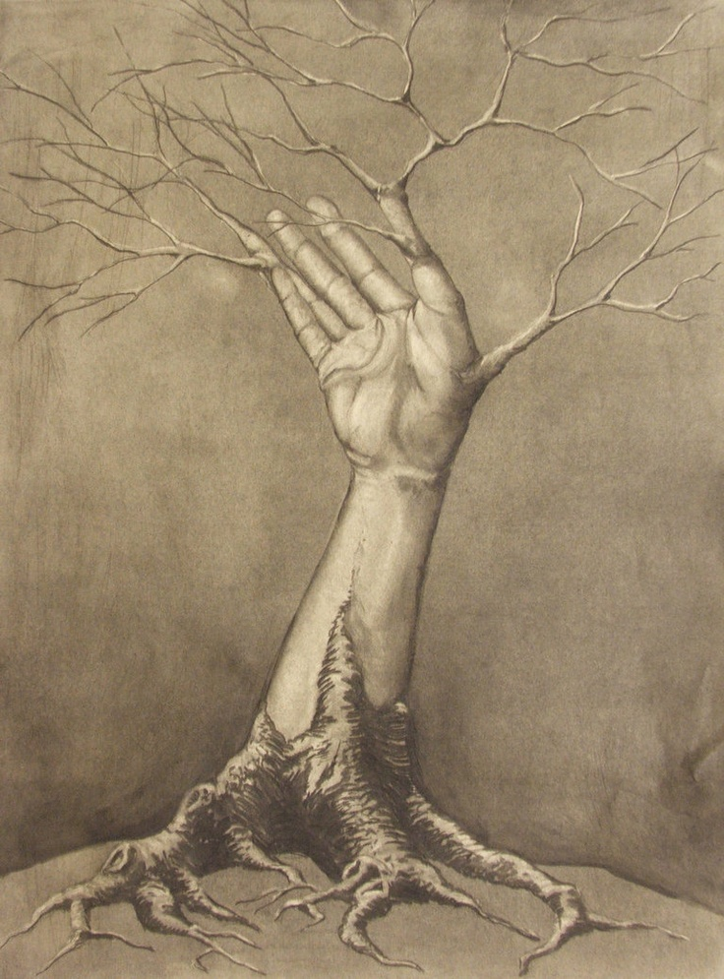
examples

Slide 21
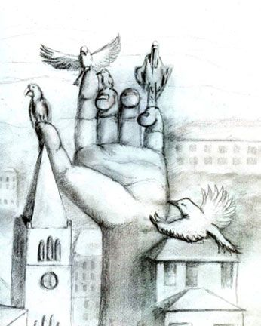
examples

Slide 22
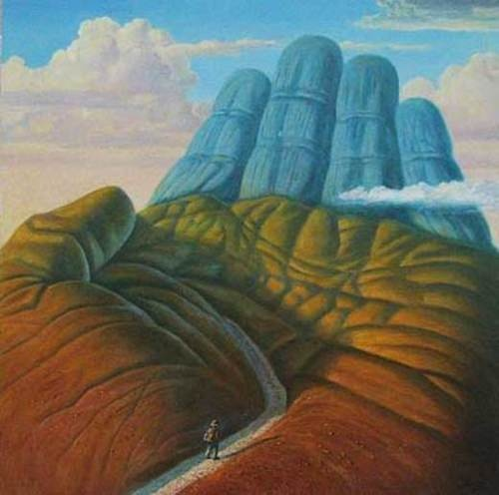
examples

Slide 23
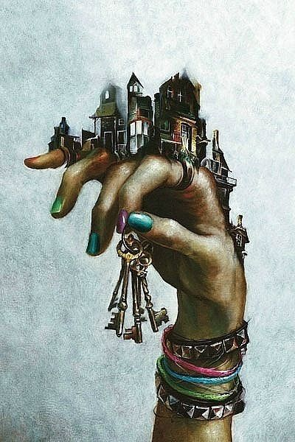
examples

Slide 24
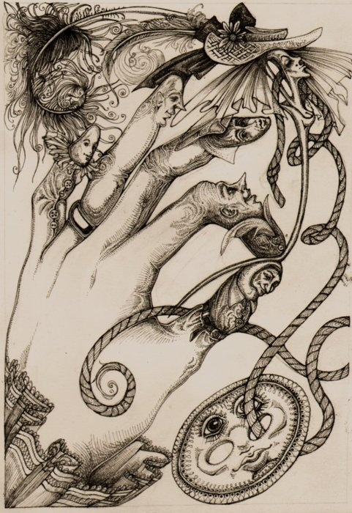
examples

Slide 25
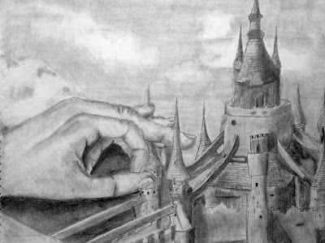
examples

Slide 26
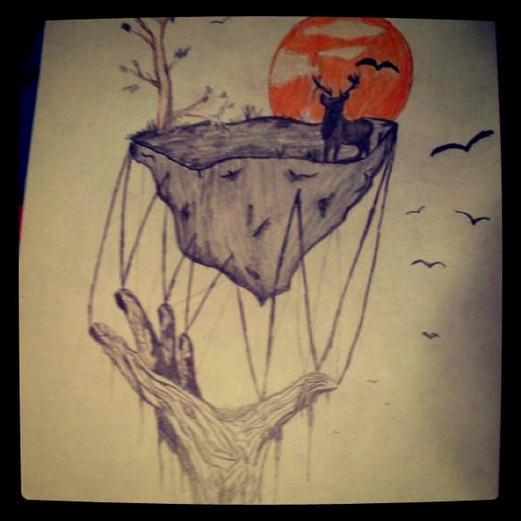
examples

Slide 27
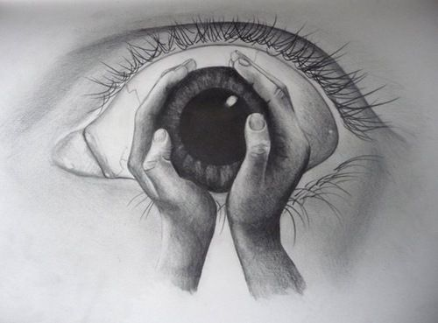
examples

Slide 28
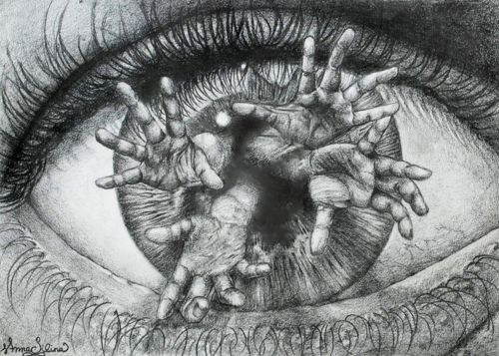
examples

Slide 29
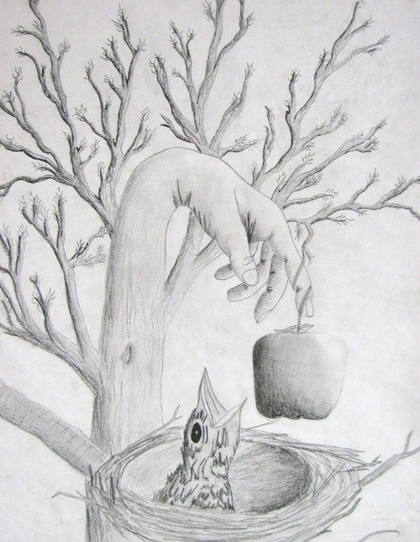
examples

Slide 30
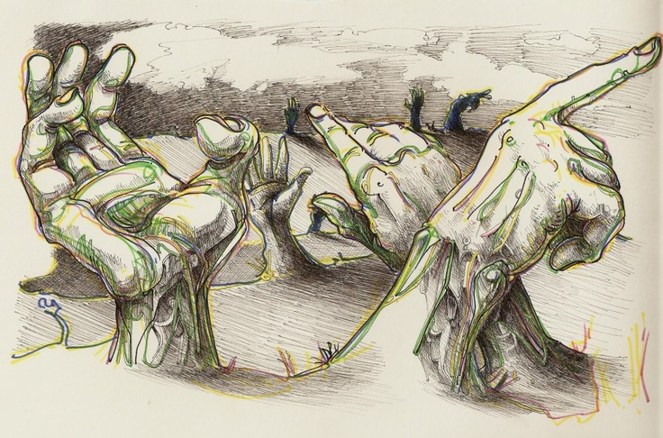
examples

Slide 31
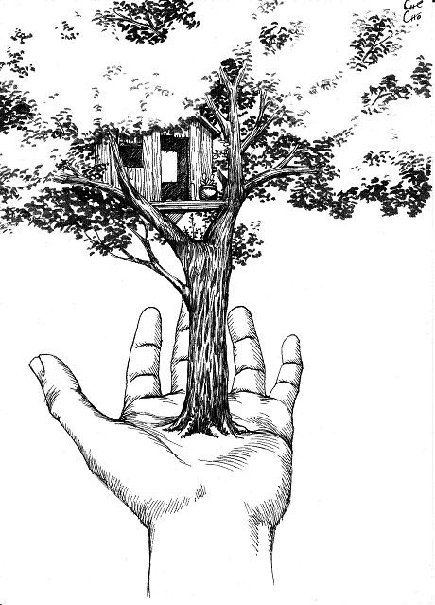
examples

Slide 32
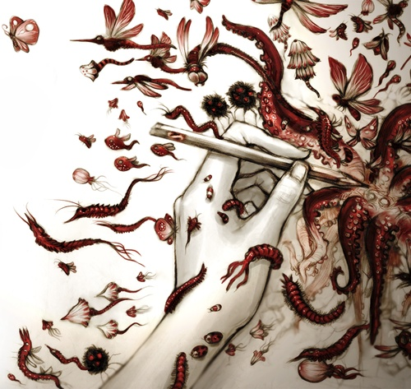
examples

Slide 33
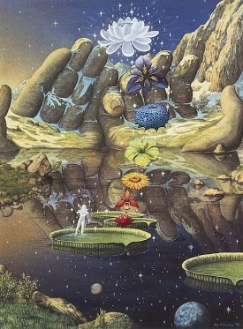
examples

Slide 34
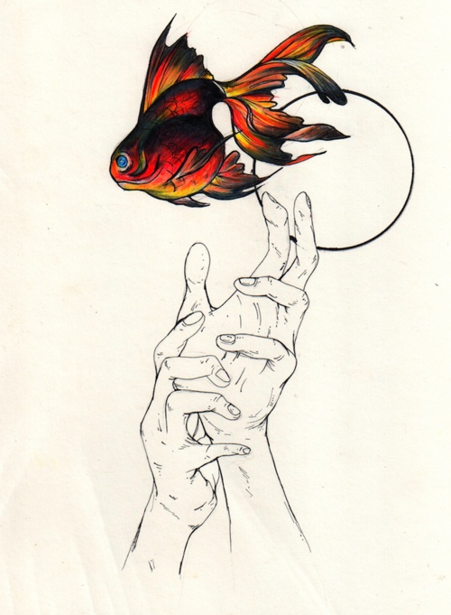
examples

Slide 35
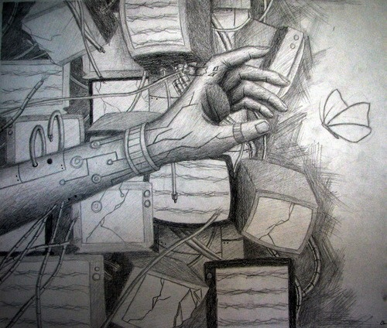
examples

Slide 36
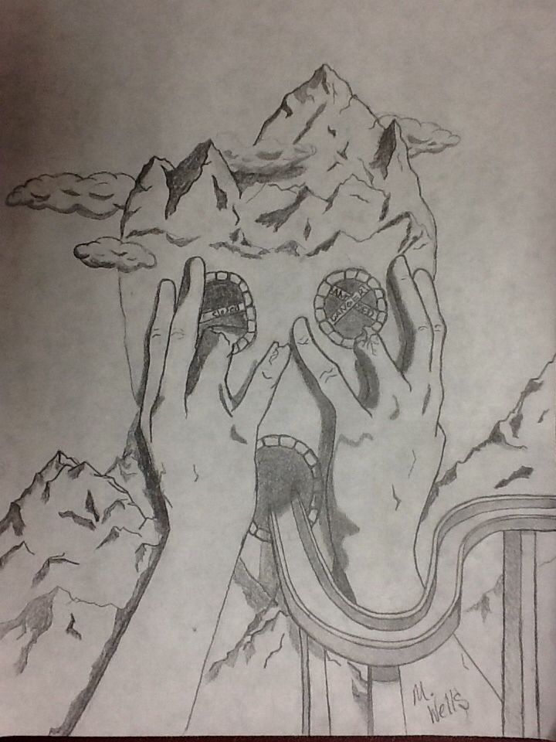
examples

Slide 37
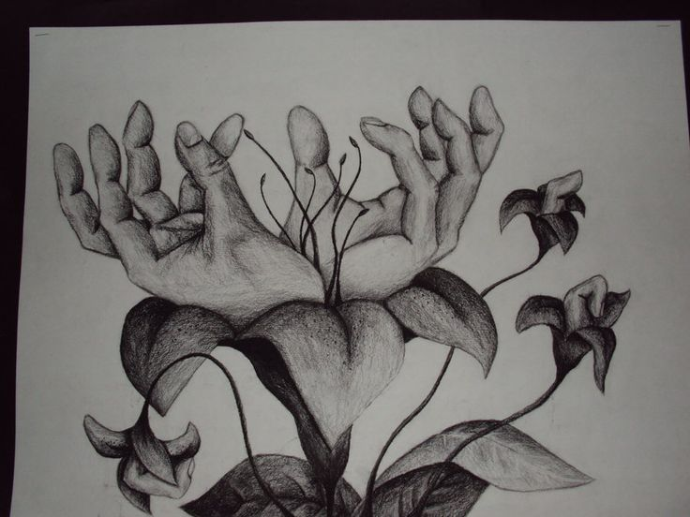
examples

Slide 38
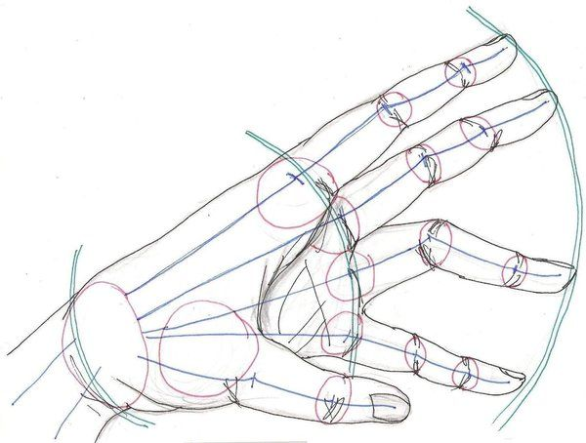
examples

Slide 39
Project objectives
Explore perspective as it is applied to creating a surreal space *remember sometimes the rules can be broken if it adds to the surrealism of the art
Explore landscape
Explore the theme of hand-scapes, surrealism, dreams…or nightmares
Continue to explore theme in art
Continue to build skills in adding color and values to artwork

Slide 40
How to…
Brainstorm ideas on how to combine your theme and a dream
Sketch out your dream idea and add in your hand(S) as the surprise element
Remember your landscape vocab and how it effects your objects!
Discuss with 1 or more group members before showing me.
Begin on project paper *remember landscape vocab and values.

Slide 41
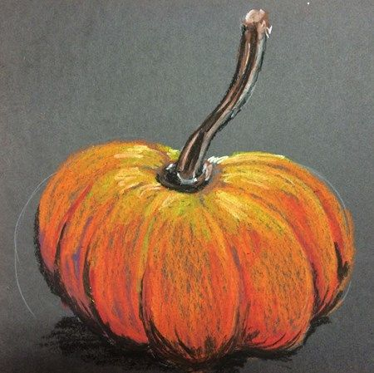
Bell ringer
Still life- part of what made surreal artists so good was understanding how to create and manipulate objects without having to stage them for their artwork. This level of mastery was developed through still life practice and observation. For this weeks bell ringer create a still life artwork of the pumpkin at your group.
Remember not to move the pumpkin’s position from day to day.
Look at your pumpkin often so you are achieving the correct shape, proportion, details and color.

