Slide 1
Exploring Landscapes
Focus: landscapes (foreground, middle ground, background), Theme.
Grades 5

Slide 2
Space and perspective
What is space?
What is perspective?
How can art have space and perspective?
Why do you think space and perspective is important in art?
How can we create space and perspective in art?

Slide 3
Landscape
What is a landscape….?
What can be found in a landscape?

Slide 4
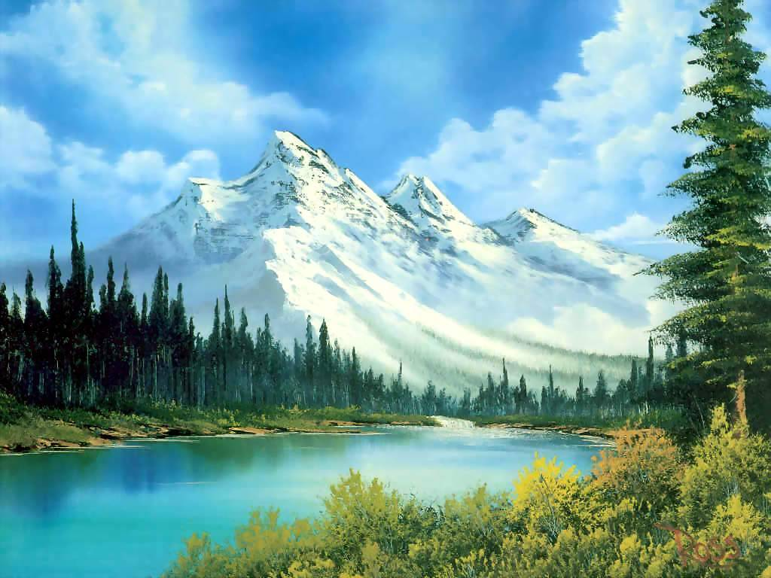
Landscapes
They are any painting, drawing or photograph of the outside.
They can be of the city, ocean, sea, river, mountains, forest, town, neighborhood….anything outside.

Slide 5
How to Make a Landscape
Landscapes have a foreground, middle ground and background.
Who can describe where the foreground is found?
What about the middle ground?
What about the background?

Slide 6
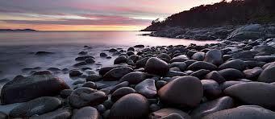
Foreground
Things in the foreground are larger than anything else and are closer. They are the front of the art.

Slide 7
Middle Ground
Things in the middle ground are found in the middle of the art and are smaller than the things in front of them.

Slide 8
Background
Things in the background are the furthest away, the smallest things and the lightest things.

Slide 9
Practice
Let’s make a sample landscape together.
Each person will need a blank piece of paper and a pencil
Each person will need a strip of paper that says; FOREGROUND, MIDDLE GROUND, BACKGROUND.
Lets start with a foreground…what should we make in our foreground…? Middle ground…? Background?
Next label your areas with the correct term by gluing your strips of paper to your landscape. Add color if you have time.

Slide 10
Theme
what is a theme?
Our theme will be Dino City ‘Scapes
What do you think our theme means? What will we be doing?

Slide 11
Review
Line and shape
How will we be using line and shape in this project?
How will the way we use line and shape change for this project?
How will perspective effect the shapes you plan on drawing?

Slide 12
Examples.

Slide 13
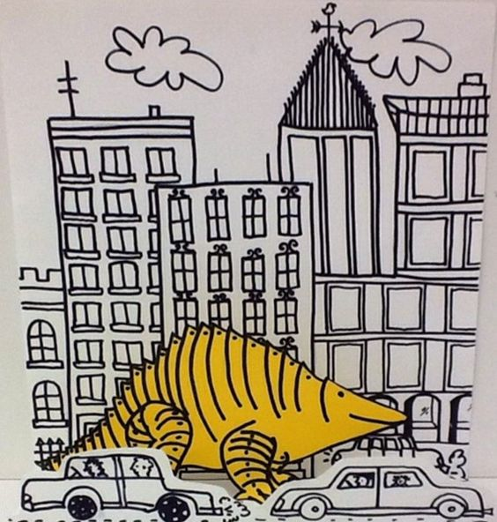
Examples.

Slide 14
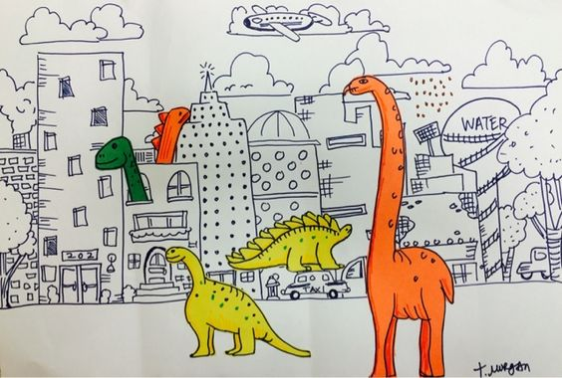
Examples.

Slide 15
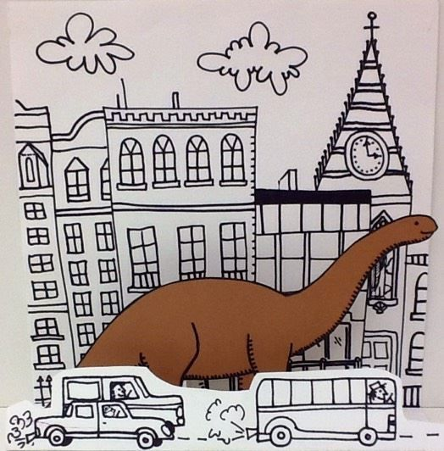
Examples

Slide 16
steps
Explore landscapes, perspective and space in art
Create a landscape to help us understand FOREGROUND, MIDDLE GROUND AND BACKGROUND
COLORED AND TURNED IN
Discuss theme of project and review line and shape in new project
Sketch dinosaurs to be used in your project *no tracing
Sketch city to be drawn for project
Receive project paper and draw lightly and BIG
Outline your drawing in markers and color everything except the SKY with crayons and colored pencils
Use watercolors to paint the sky
Turn in and display

Slide 17
Objectives and Grades
Explore landscape art through practice, sketching and a project with a specific theme.
Explore themes in landscape art
Create a landscape that has a foreground, middle ground and background
Explore landscape artists
Continue to explore line and shape in your project and with your bell ringer mini project.
landscape drawing w/ color and attached vocab
Sketch of project
Name mandala bell ringer
Finished dino city project

Slide 18
Bell Ringer #1
Read the artists bio and prepare to share

Slide 19
Bell ringer #2
Name mandala:
Line and shapes are used in art in a variety of different ways and methods in order to create all kinds of different art.
A mandala is a type of art created in India
Follow the steps on your hand out to create a unique radial design (mandala) using your name and the colors you choose!
Color neatly and turn in in 1 week after working on it during bell ringer time.

