Slide 1
Communities Around the World
Community, research, combining art and social studies, collage/ mixed media, fantasy house

Slide 2
What is a community?
How can we define community?
Each person take 3 minutes and write down their answer
Next as a group discuss what your answer was and how you can combine all your ideas into 1 group answer.
What does a community look like? Does this answer depend on location and if so why?
What and who does a community need to thrive and survive?
Answer this in a group; you should have 10 or more ideas
Prepare to share
Why are communities important?
Does this class have a community?
Does this class’s community differ from the classroom next door and how?
What else do we need to know about communities?

Slide 3
Communities around the world
What if we lived in a small village in Africa….how would your previous answers change?
What is a community?
What does a community look like?
What does a community need?
Who does a community need?
Why is a community important?

Slide 4
Genre Theme
Understanding how people live around the world has been an interest to artists for a long time.
Read and prepare to share and discuss the article at your tables about Genre Painting.

Slide 5
Genre Theme
How can the Genre Painting theme connect with our topic of community?

Slide 6
Research
Why is research important to an artist?
What kind of research might a Genre Painting artist have had to do before painting their artwork?
Have we done any type of research for this project yet?

Slide 7
Your project
For this project you will continue to explore what a community is, its importance and what you believe a community looks like visually much like a Genre artist would have done in the early 1900’s.
You will be researching specific communities around the world with the help and guidance of Mrs. M and guided questions.
Your goal is to further understand what a community and how this definition extends to parts of the world.
For your art projects you will create a large scale group “house” for others to interact with your research, a community collage based on how you think a community looks, and a fantasy house made of cardboard.

Slide 8
Research days
You will have several days in the library with Ms. L and Mrs. M who will walk you through things such as databases, appropriate sources and how to find your research needed on your chosen community.
Make sure you are thorough and are answering all the questions in complete sentences when needed.
You will only have library time to conduct your research and will be graded on your research and on a short presentation in class on your chosen community/ place.

Slide 9
projects
As a group you will help create parts of a community “house.” (roof, windows, walls, flower box etc)
Community collage- what do you believe a community looks like? Using drawing skills, magazines, mixed coloring materials, words etc. create a collage of what you think a community looks like.
Fantasy house- a large part of a community is its buildings. A more personal part of your community is your home. Out of cardboard and paint create your fantasy home.

Slide 10
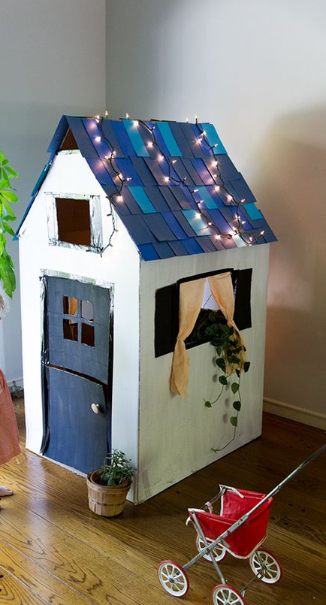
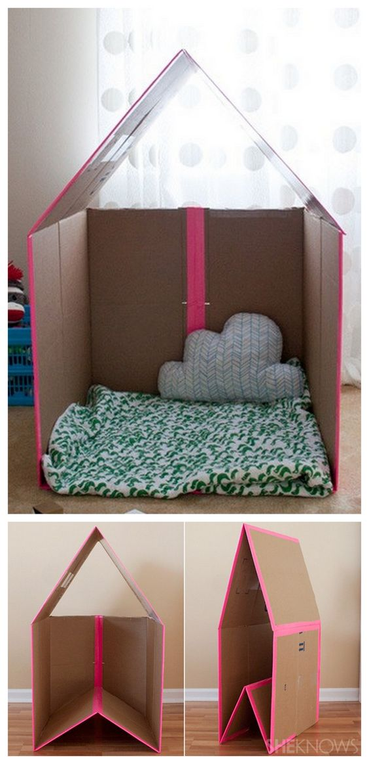
Examples

Slide 11
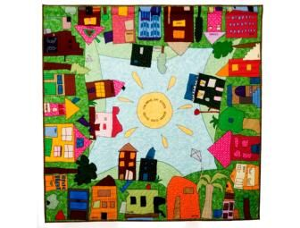
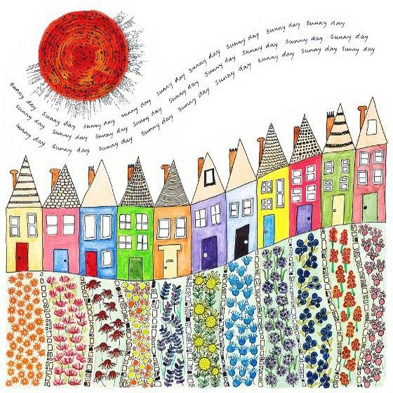
Examples

Slide 12
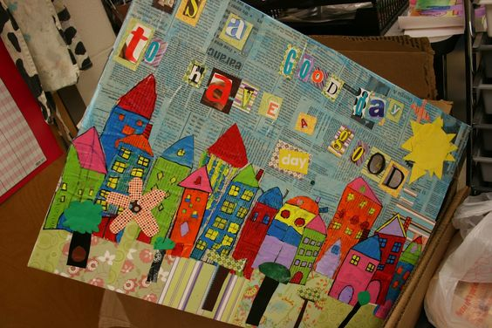
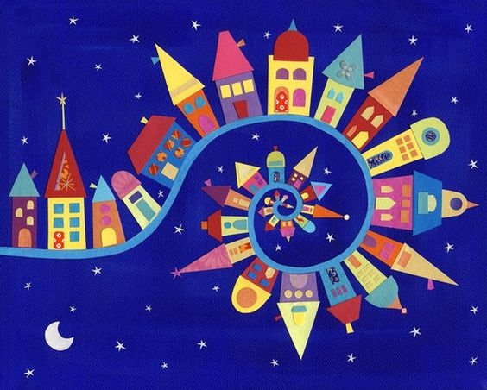
Examples

Slide 13
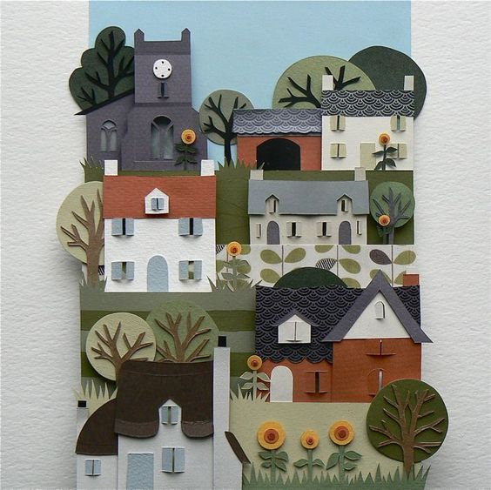
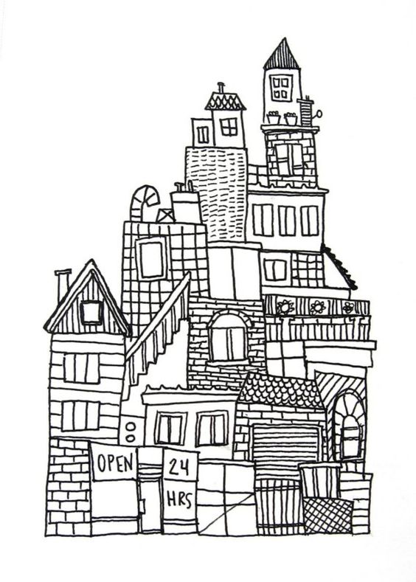
Examples

Slide 14
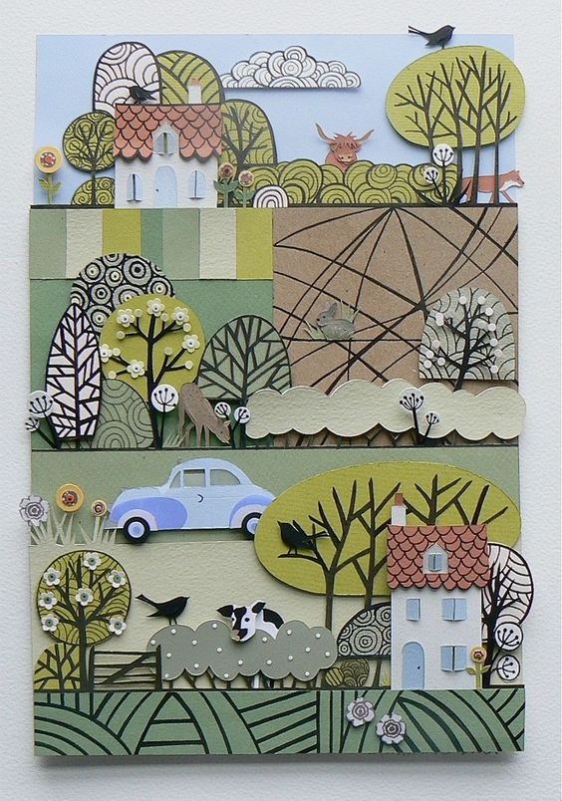
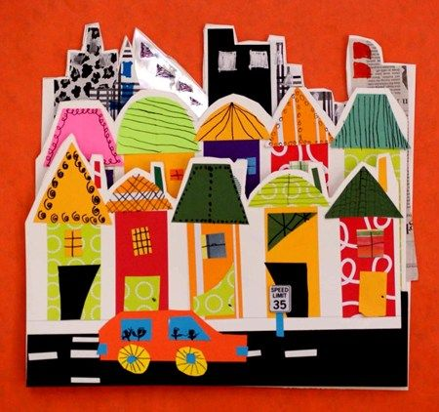
Examples

Slide 15
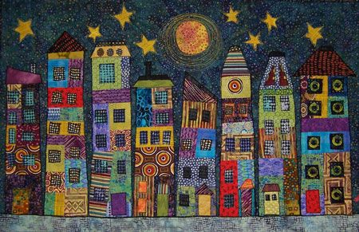
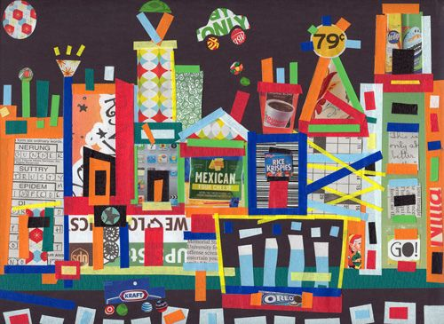
Examples

Slide 16
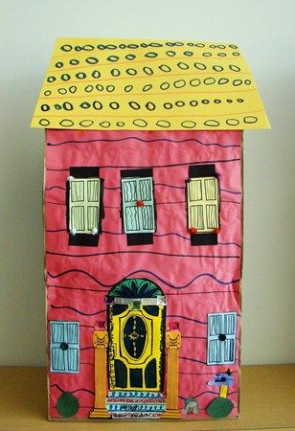
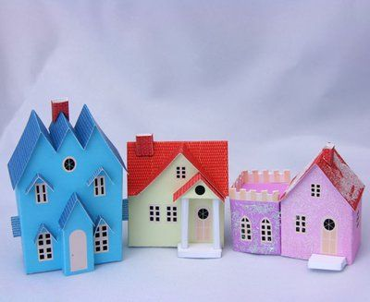
Examples

Slide 17
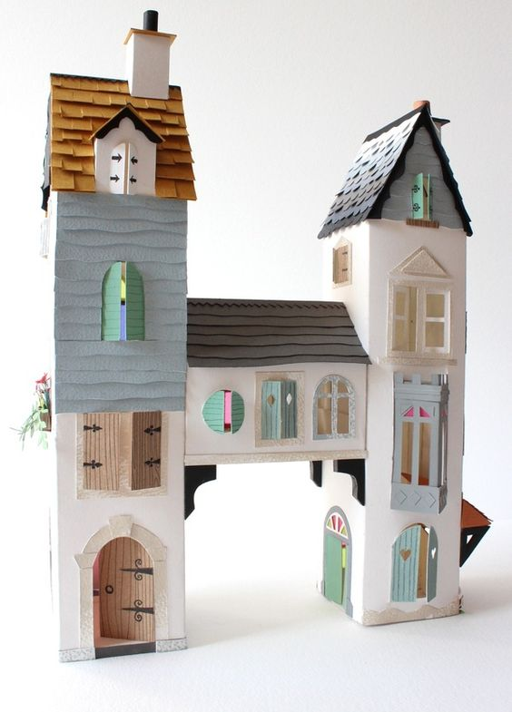
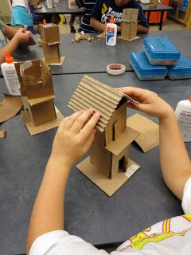
Examples

Slide 18
Objectives and grades
Explore the theme of community in art and Genre Painting
Research a specific place in the world as it applies to your theme of community
Create a collage based on community
Create a 3d structure
Continue to use drawing and color skills
research and presentation
Group house
Collage
Fantasy house

Slide 19
Do now/ Bell Ringer 15 mins
In your group work on your portion of our community “house.”
Roof
Window 1
Window 2
Wall 1
Wall 2
Wall 3
Flower box

