Slide 1
Color Wheel Birds
Color Wheel, color mixing, drawing, shapes, lines, construction

Slide 2
Shapes and Lines
Why are shapes and lines important to artists?
What must come first?
Why are shape, line and color so important that they are part of the elements of art or the language of art?

Slide 3
Line to shape
A line is a dot that went for a walk….
What does this mean?
How do lines turn into shape?
What are some examples of shapes?
What shapes do you see in the next slide?

Slide 4
Shape to drawing

Slide 5
Line, shape, drawing

Slide 6
Practice- 10 mins
Practice making lines and shapes on the given worksheet.
Shapes:
There are 2 different types of shapes- ORGANIC and GEOMETRIC
ORGANIC SHAPE- natural shapes that have curved lines and corners. These are lines you come up with using your imagination.
GEOMETRIC SHAPES- these shapes are the shapes you learned in elementary school and use most often in math. They have sharp corners and require a ruler to create.
Lines- create as many different types of lines as possible and name them. Use different colors to make it more interesting.

Slide 7
project
Objectives:
Explore color using color mixing and your color wheel guide
use and mix all the colors from the color wheel on your project
Use line to create simple shapes
Combine line and simple shapes to create your projects drawing.
Use construction techniques (cutting, gluing, layering) to build your project
Create a colorful cardboard bird using line, shape and color knowledge.
During bell ringer time create your first initial using line, shape and color in a graffiti style.
Explore how graffiti/ street art uses line and shapes to make art.

Slide 8
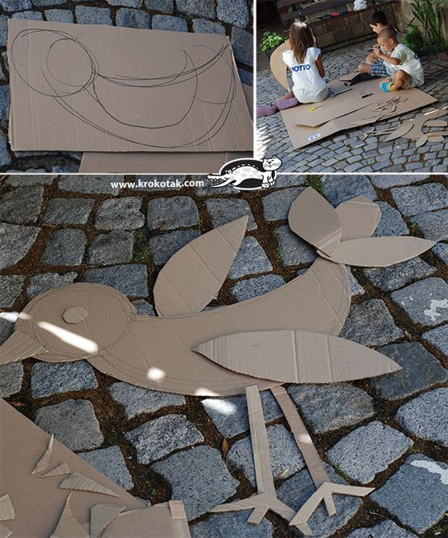
Examples

Slide 9
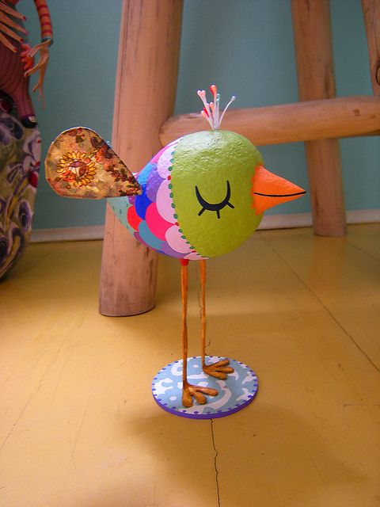
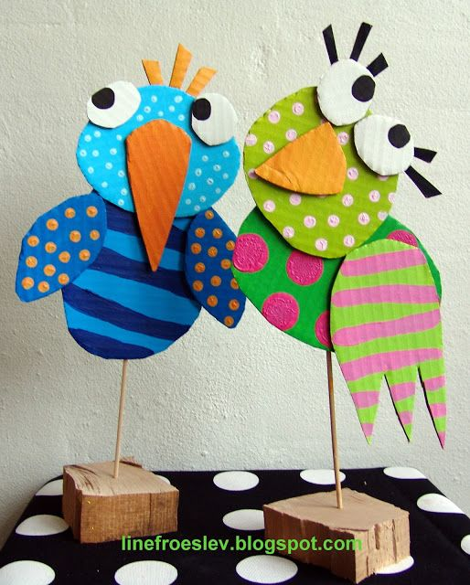
Examples

Slide 10
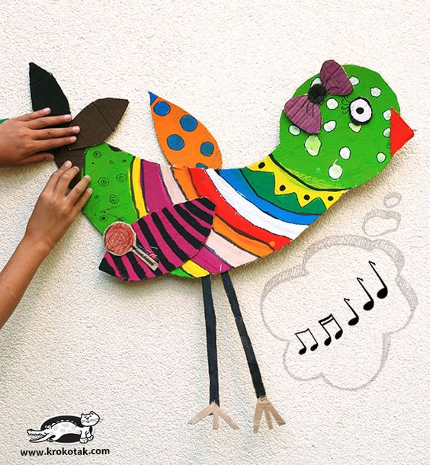
Examples

Slide 11
Examples

Slide 12
Project steps
Explore color and create a color wheel guide
Explore line and shape and practice both on worksheet
Sketch bird idea on paper
Show teacher
Receive cardboard and begin to draw and cut out bird pieces
Explore paint and mixing colors to paint bird
Once dry begin to glue together bird and construct bird
Display

Slide 13
Bell Ringer
How do graffiti artists use line, shape and color in a different manner to other traditional artists?
Mini Project:
Using the provided fonts, sketch your first initial in a graffiti style. *pay special attention to the lines and shapes
Get approval from teacher and receive project paper
Draw your initial HUGE on project paper
Use crayons and colored pencils to color in large areas and markers to color in SMALL areas.
Cut out and turn in .

