Slide 1
Color Theory
Isaac Newton and the Color Prism

Slide 2
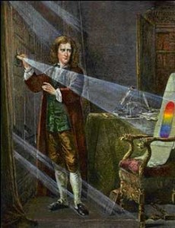
Isaac Newton
Who is he and why is he important to art?
5 minutes to find or guess the answer…..

Slide 3
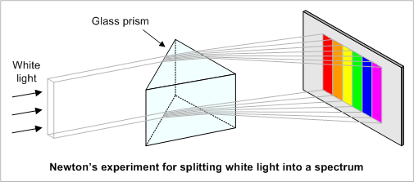
Isaac Newton
The color wheel’s roots date back to the mid-1600s when Sir Isaac Newton’s work with white light led him to the discovery of the visible spectrum of light. Newton observed the way each color of light would bend as it passed through the prism. You may have learned the term “ROY G BIV” (red, orange, yellow, green, blue, indigo and violet) in elementary school science class. “ROY G BIV” was the result of Newton’s discovery.

Slide 4
Isaac Newton
Newton observed the way each color of light would bend as it passed through the prism.
You may have learned the term “ROY G BIV” (red, orange, yellow, green, blue, indigo and violet) in elementary school science class. “ROY G BIV” was the result of Newton’s discovery.
His experiments led to the theory that red, yellow and blue were the primary colors from which all other colors are derived.

Slide 5
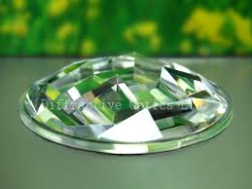
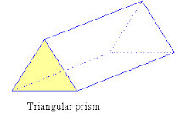
Color prisms and kaleidoscopes
Prism is usually triangular
Kaleidoscope is generally round with different flat planes/ surfaces.

Slide 6
Explore
Using a flashlight to shine through the prism make observations on what you see.
What elements of art do you see?
How does the color appear?
Next look through a kaleidoscope at various parts of the room.
What elements of art do you see now?
How does movement effect what you see?

Slide 7
Explore
Next look through a kaleidoscope at various parts of the room.
What elements of art do you see now?
How does movement effect what you see?
What colors do you see and do you see them all at once?
Share out.

Slide 8
Using color wheel and kaleidoscope
Using the kaleidoscope to look through create your own fractured image of shapes and colors.
Use a ruler to draw straight lines much like you see through the kaleidoscope.
Apply all the colors of the color wheel with values
Pay special attention to how you are coloring *craftsmanship

Slide 9
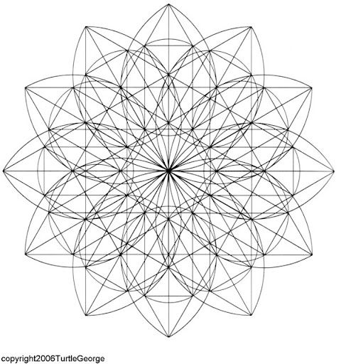

Slide 10
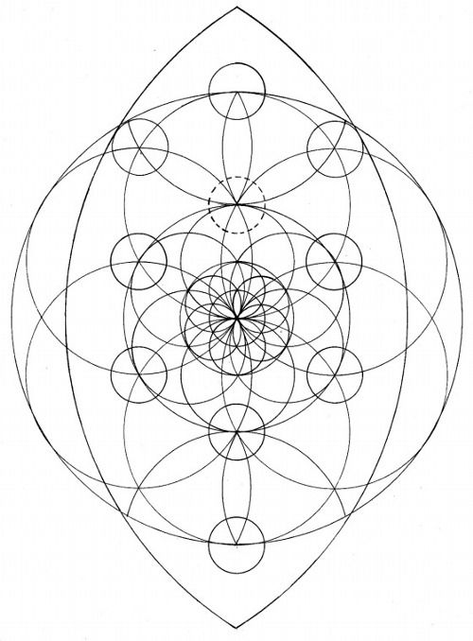

Slide 11
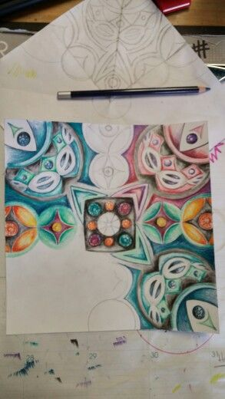

Slide 12
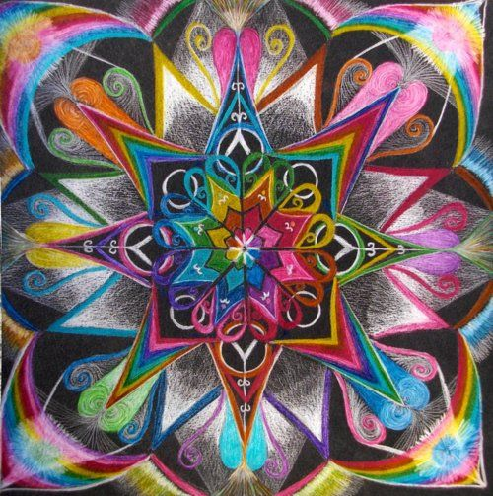

Slide 15
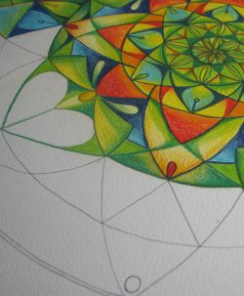

Slide 16
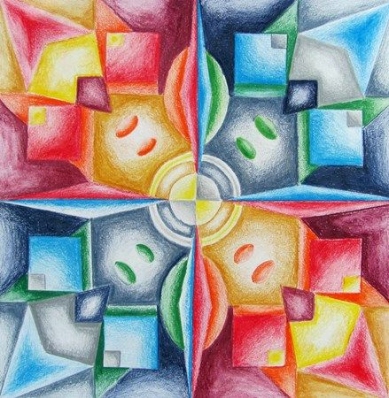

Slide 17
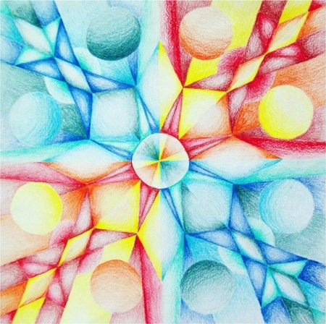

Slide 18
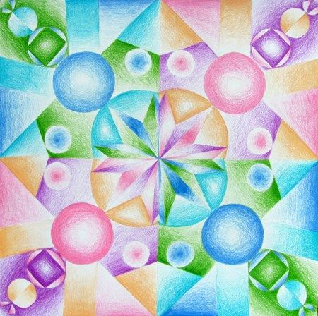

Slide 19
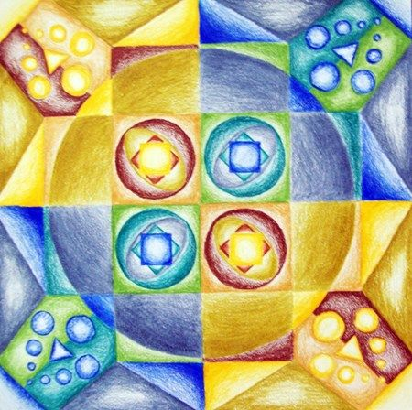

Slide 21
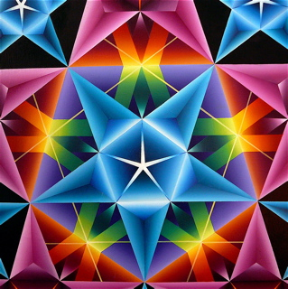

Slide 22
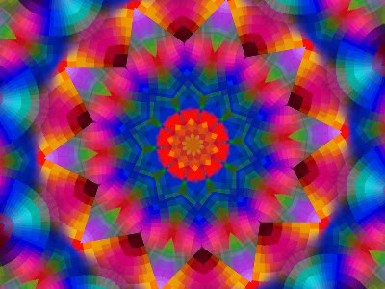

Slide 23
