Slide 1
Color mixing!
Silhouettes, tint, hue, shade, tone

Slide 2
Color mixing review
What is color mixing and why is it important?
What would happen if artists didn’t use color mixing?

Slide 3
Color review
Primary colors
Secondary colors
Tertiary colors
Values of a color….

Slide 4
Creating Hues of a color
Tint- can be created by adding white to a color. The more you add the lighter the color will become
Tone- can be created by adding gray to a color. This effectively dulls and somewhat darkens a color.
Shade- created by adding black OR the complimentary color to a specific color. Example- purple + complimentary yellow= a shade of purple.

Slide 5
Silhouette
What is a silhouette?
How can a silhouette be used in art?
How does it work?

Slide 6
Project
With a partner create a silhouette of yourself, full body, in a fun and appropriate pose.
On Bristol board begin to create circles in various sizes to be painted *use all your space!
Begin color mixing!
You must mix each color of the color wheel at least once. Aim for the rule of 3 per color (each color has a tint, medium hue, tone.)
You should have a minimum of 36 circles, the more you mix the better your silhouette will look!
Cut out all your circles and apply them in the order of the color wheel to your silhouette.

Slide 7
Objectives
Explore the elements of art, line, shape and color
Explore the color wheel and its properties
Explore color mixing through color hues (tint, tone, shade)
Explore silhouettes in art through making with a partner
Explore craftsmanship and construction with the completion of your project.

Slide 8
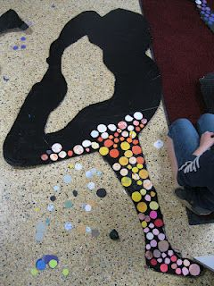
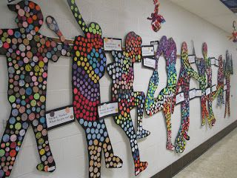
Examples

Slide 9
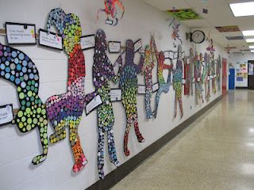
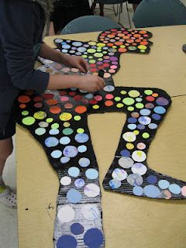
Examples

Slide 10
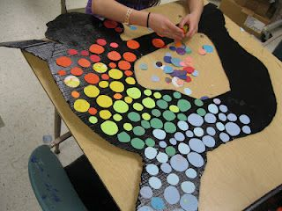
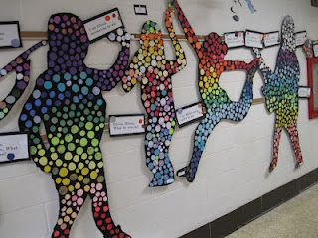
Examples

Slide 11
Bell Ringer
Eric Carle bio read and share
Read the bio and prepare to discuss
How does he use color mixing and paint similar to our current method?

