Slide 1
Social and Global Issues
Street Art, Banksy, Social/ Global issues, installation art, group collaboration

Slide 2
Essential Question
How can I use my art to make a statement about real world global and social issues?
Social and Global issues
Street Art
Communicating ideas through installation art

Slide 3
Making a statement
How can art be used to communicate to people?
How can art be used to make a statement to a large group of people?
What kinds of large/important statements might an artist be making with their artwork?

Slide 4
What are real world problems?
What are real world problems? List examples
What are social problems? List examples
What are global issues? List examples
How might an artist convey their ideas about one of the above topics?
In your groups research and answer the 4 questions above. Be prepared to share.

Slide 5
Who is Banksy?
Who is the artist Banksy?
What is street art?
What is installation art and how is it similar or different from street art?
Take 10 and read the Banksy bio before sharing out to the class

Slide 6
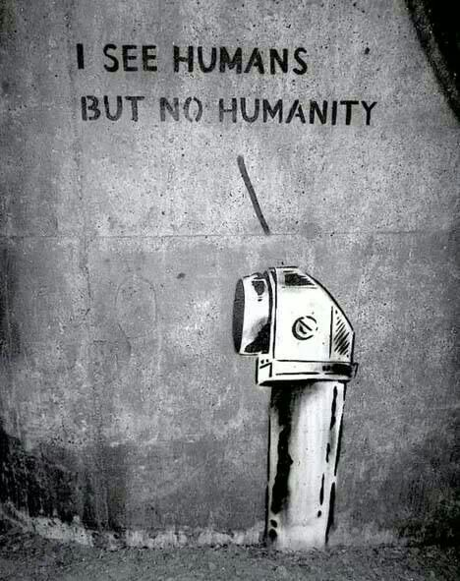

Slide 7
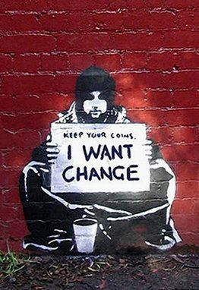

Slide 8
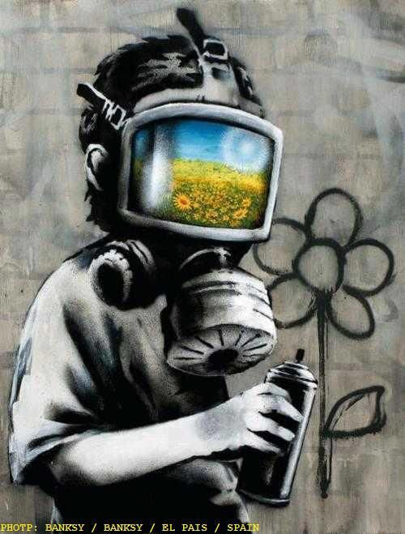

Slide 9
Banksy Packets
Each person will receive a packet to read about Banksy and his artwork. Pay special attention to how his artwork is created and the topics he is trying to convey in his artwork.
Prepare for a discussion and critique on packet in 1 week.

Slide 10
Research Packets
You will be working in groups of 3-4. each person will still conduct their own research and receive a packet and citations grade.
Research and choose a social or global issue for this project.
Complete the Banksy packet for better understanding about street art
Complete the research packet/guided questions about your chosen issue and to create an installation artwork.

Slide 11
Choosing an issue
Choose an issue that is personal to you to make it more interesting.
Choose an issue that you are going to relate to and are going to be able to communicate ideas about through art.
Research this issue extensively so your artwork fully displays your facts and ideas.

Slide 12
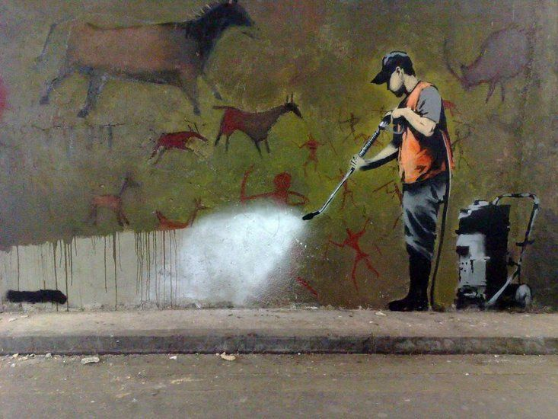

Slide 13
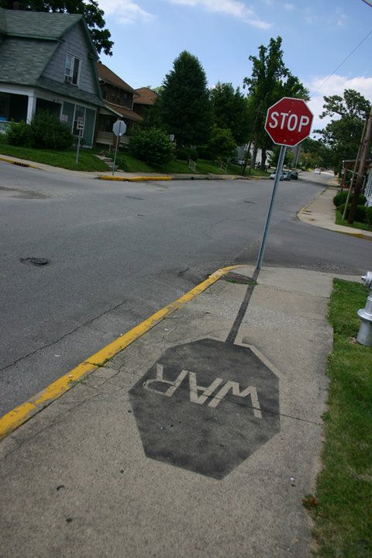

Slide 14
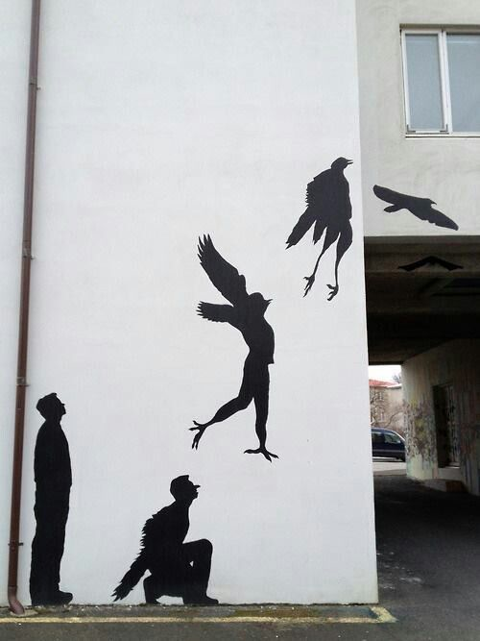

Slide 15
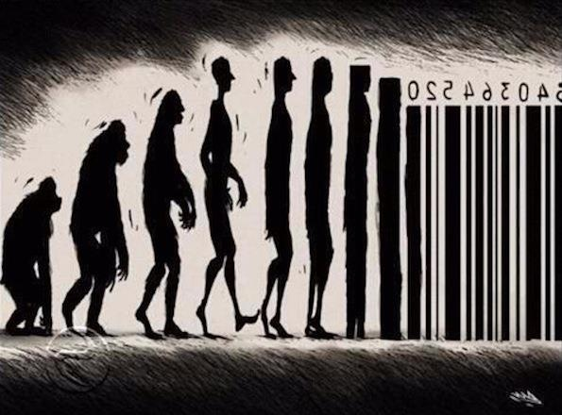

Slide 16
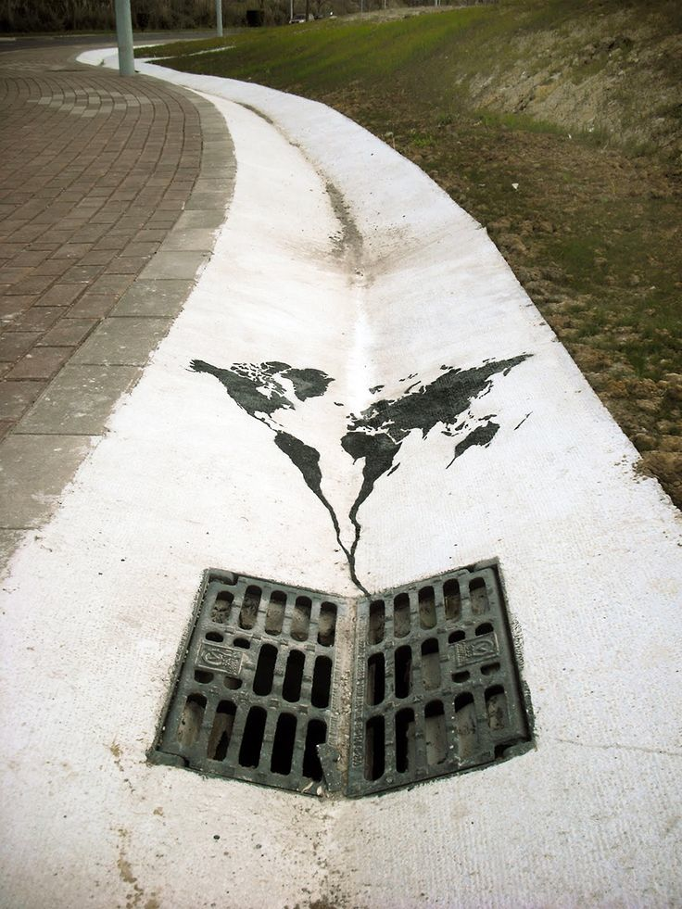

Slide 17
Stencil art
What is a stencil?
Why would street artists use a stencil?

Slide 18
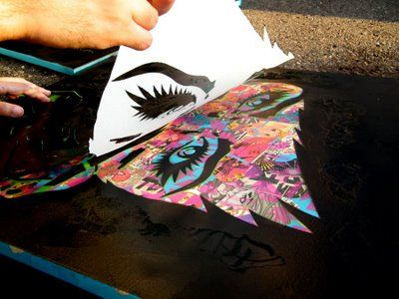

Slide 19
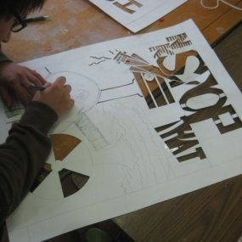

Slide 20
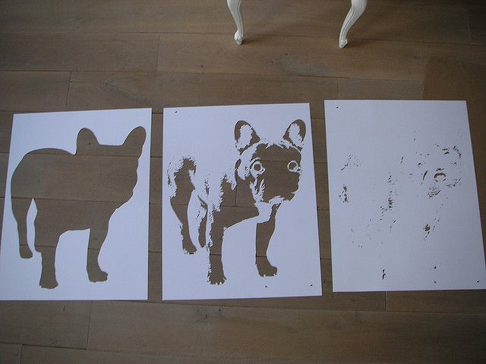

Slide 21
Project Objectives
Explore social/global issues around the world
Research a chosen topic and apply research to your project idea.
Explore street art and installation art
Install your project and present it to an audience

Slide 23
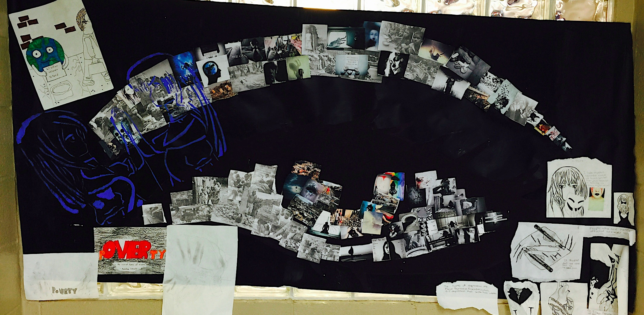

Slide 24
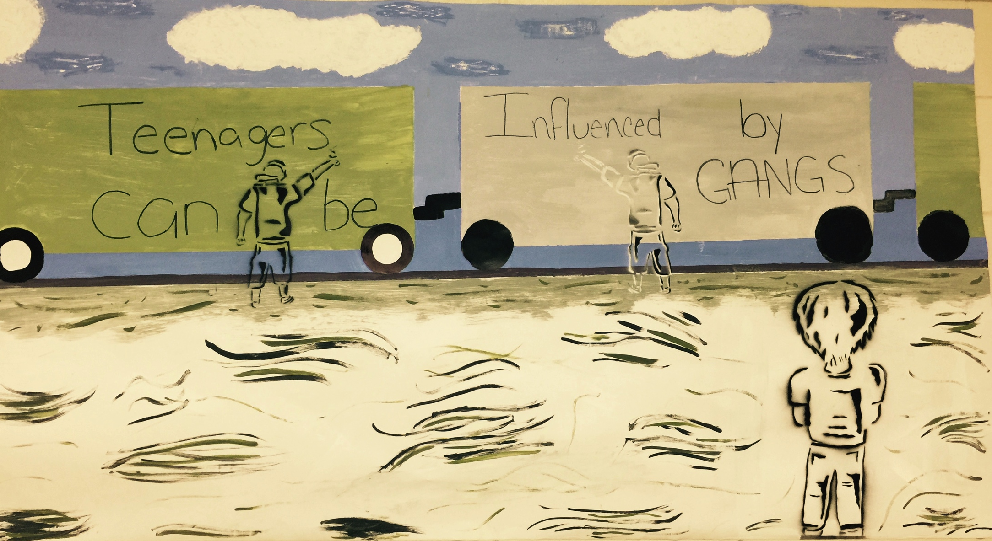

Slide 25
Project steps
Group intro and activity
Begin Banksy research packet
Begin chosen topic research packet w sketches
Consider your stencil and background painting
Preliminary critique and revisions
Begin project *background and stencil
Install and present
Turn in both research packets

Slide 26
Grades
Banksy bio and artwork analysis packet
Groups chosen topic research packet *individual
Sources and citations check from packet and conducted by Mrs. M
Group mural and presentation
Individual mural grade and presentation grade
6+ grades in total

