Slide 1
Aztec textiles
Group/ collaborative, textile, pattern, Aztec sun, informative poster

Slide 2
Explore 20mins
Using the books and printouts explore the Aztec people, location, customs, history etc.
As a group create an informative poster to be shared with the class

Slide 3
Pattern
What is a pattern?
What 3 elements of art are used to create a pattern?

Slide 4
Pattern practice
Using the following images and the books create 5 different patterns inspired by Aztec textiles (fabrics and patterns) on your worksheet.
What types of shapes do you notice?
What types of colors do you notice?

Slide 5
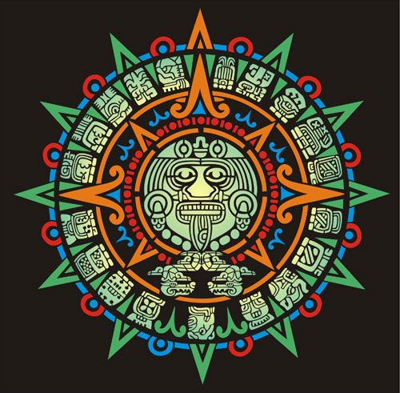
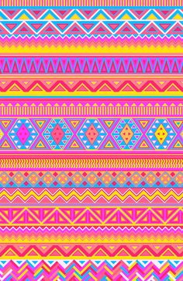
Patterns

Slide 6
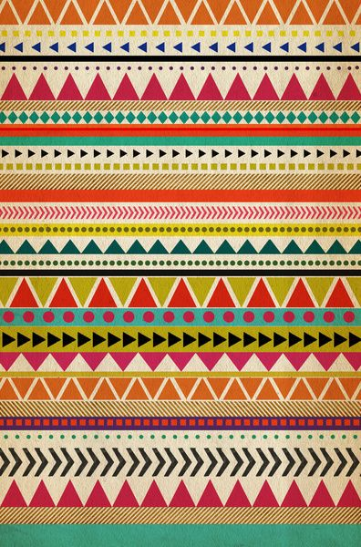
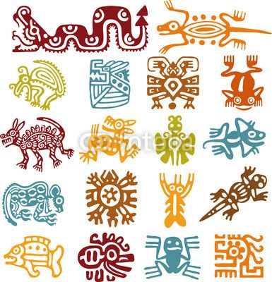
Patterns

Slide 7
Patterns

Slide 8
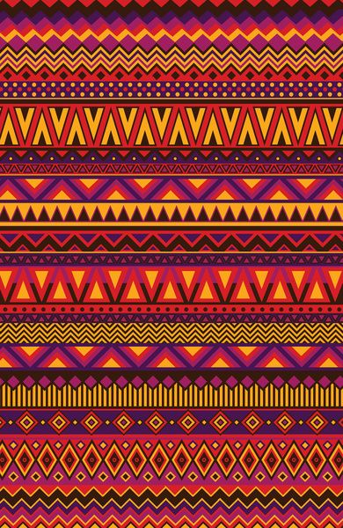
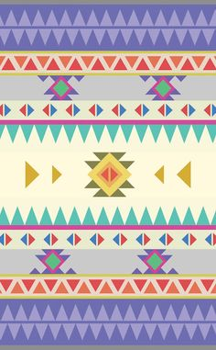
Patterns

Slide 9
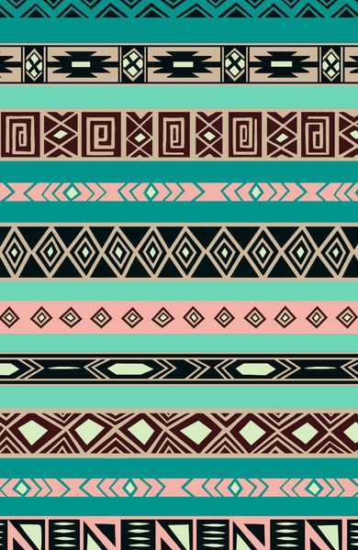
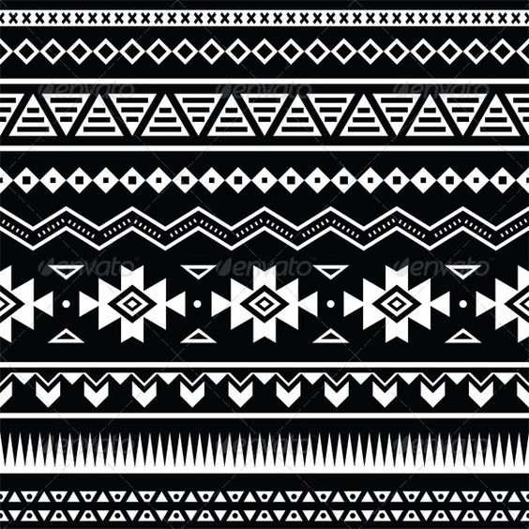
Patterns

Slide 10
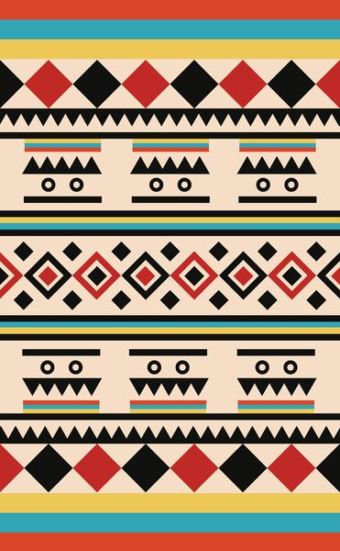
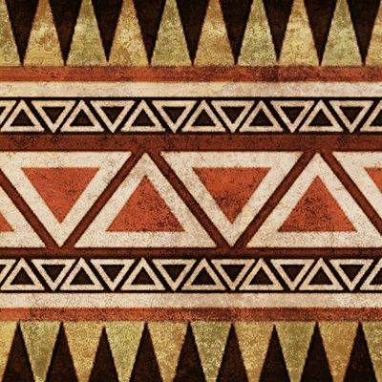
Patterns

Slide 11
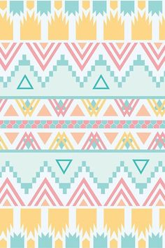
Patterns

Slide 12
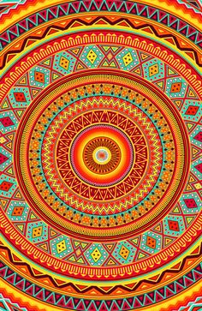
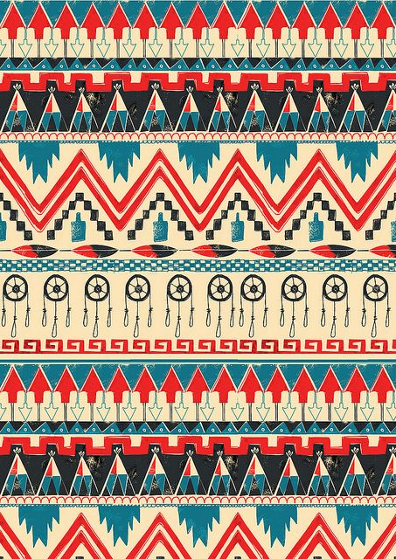
Patterns

Slide 13
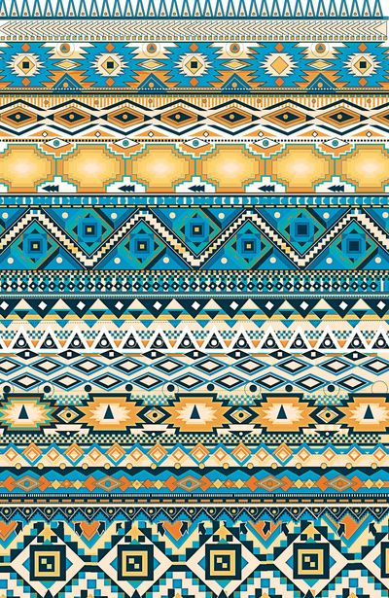
Patterns

Slide 14
Project
Textiles are woven fabrics usually with a pattern on them.
For your project you and your group will create a large textile based on Aztec patterns.
Make sure you are using rulers when necessary
You may use paint, crayons and colored pencils and markers
When you are done you will receive yarn to attach to the bottom of your textile.

Slide 15
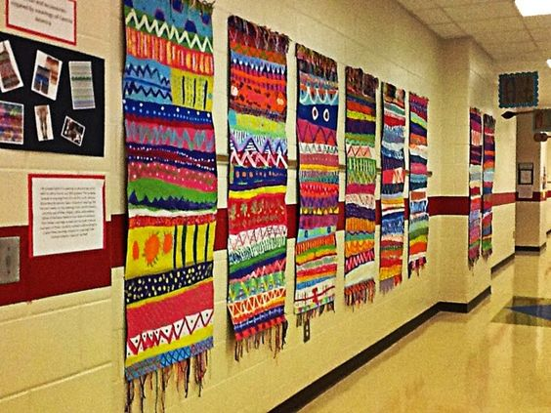
Examples

Slide 16
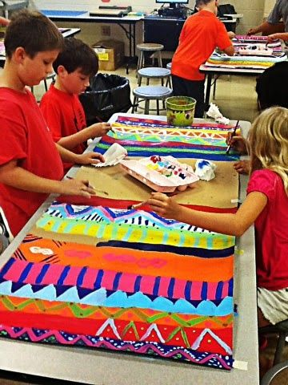
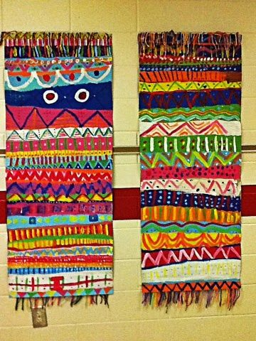
Examples

Slide 17
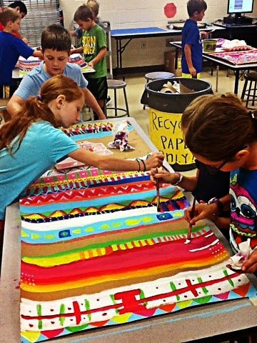
Examples

Slide 18
Objectives and grades
Explore pattern as line, shape and color is used
Explore Aztec history and textiles
Work as a group to create an informative poster and large scale project
Create a large scale Aztec patterned textile
Create an Aztec sun during bell ringer time
Group poster
Group project
Aztec sun

Slide 19
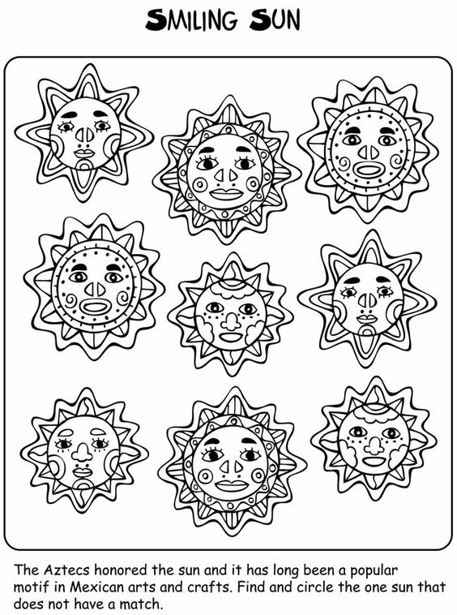
Bell ringer; Aztec Sun
During your warm ups create an Aztec sun.
The Aztec’s honored the sun in many different ways.
The center of the motif was a smiling face of the sun. The face had eyes, eyebrows, nose, smile and cheeks.
In a radial design and using Aztec patterns finish your suns rays.
Use crayons to color

Slide 20
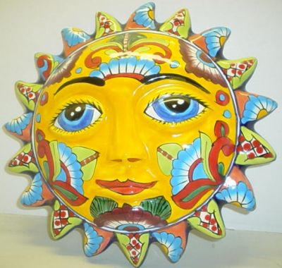
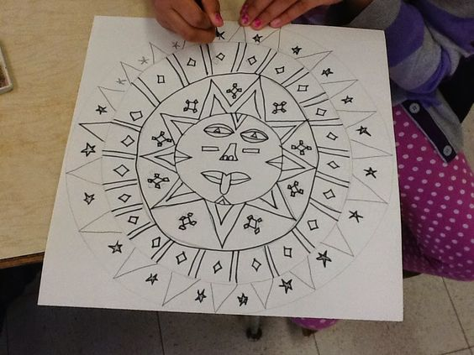
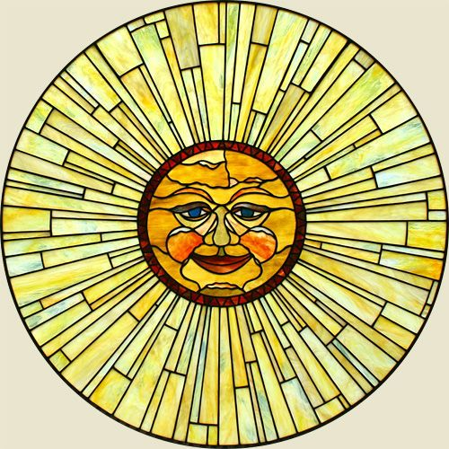
Aztec suns

